Slide 1
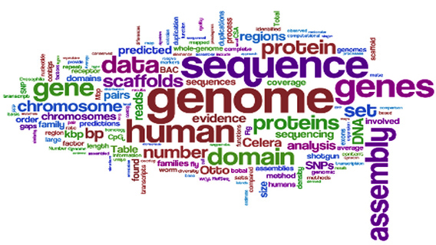
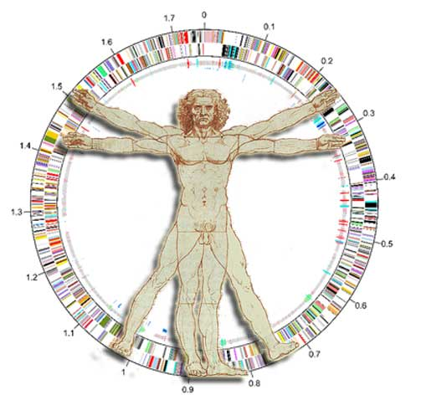
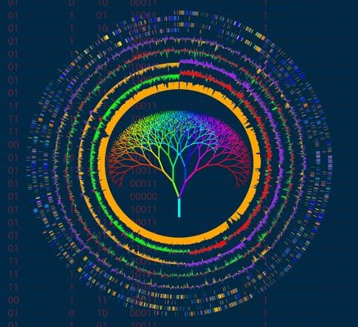
TATTTGATTTTTTGCTTAATTTTTATGTAATTACTTCCCCACAATTTTTGCCCACATATTGTGGATAAAT
ACCTTTAATCTAGAAATTACAATGAATGTTGTTGAAGAAGCACTTGGTGCTGTATTAAAAACTAAGAAGA
TTTCCACATTTTATTCACAATGTTGATAAGTTGTGTAAGTCGACTTGTTGGCTTTATAAAGCAAATGACA
CACTGAAAGTTATCCACAAACAAATTTTTCAAAAGTGTTTAAATCAAAAAGTTATCCACAAATAATGTGG
AAAACTTTTTAATAAATTTGTCGTTTCTTATGCTATCATAGTTTTACATAAATTATTAACTACTATAGGG
AGGCAGTCATGAGTCCAAACAGCACATTATGGCAGACAATATTACAGGATTTAGAAAAACTATACAACGA
GGAGACTTACAACGAGCTATTTCTACCAGTGACTTCTACTTTTAAAGATCAAAACGGATTACTTACAATG
GTTGTAGCTAATGAGTTCTTAAAGAATCGTATCAATAAACTATACATTGCAAAAATTAACGAACTTGCTA
CAAAATATTCAAGTACTCCAGTTAGATTGAAATTCGTATCACAAGAAGAAGTTATTGAAGAACCAGTAGC
TGATCGTAAATTAACCATTGATTATCGTCAAGGGAACTTAAACTCTACCTATACCTTTGACTCTTTTGTT
GTTGGAAAATCTAACATGTTTGCTTTTCGTATGGCGATGAAGGTTGCTGATCAACCTGGAGCAGTAGCAA
ACCCTTTCTACATATTTGGTGATGTAGGTTTAGGTAAAACCCATCTTATGCAAGCAATAGGTAACTATAT
ATTAGATAATGATGTCGAAAAACGTATCTTATATGTTAAAGCTGATAACTTTATTGAAGACTTTGTATCT
TTATTATCAAGAAACAAAAATAAGACTGAAGAATTCAATGCTAAATATAAAGATATTGACGTTATATTAG
TAGACGACATCCAAATTATGGCAAATGCTAGTAAAACTCAAATGGAATTCTTTAAGCTCTTTGACTACCT
ATATTTAAATAATAAACAAATCGTTATAACATCTGATAAACCAGCTTCACAATTAACAAATATCATGCCA
CGTTTAACGACACGTTTTGAAGCTGGTCTCTCTGTAGACATACAAATACCTGAATTAGAACATAGAATAA
GTATTTTAAAGAGAAAAACAGCTACATTAGATGCCAACTTAGAGGTAAGTGAGGATATTTTAACCTTTAT
AGCATCTCAATTTGCAGCAAACATTAGAGAAATGGAAGGTGCACTCATTCGTTTAATTAGTTATGCACAG
ACCTTTAATCTAGAAATTACAATGAATGTTGTTGAAGAAGCACTTGGTGCTGTATTAAAAACTAAGAAGA
AAACAAATGATTTAAACGAAAATAACTACGATAAGATCCAAAGTATTGTAGCAGATTACTTCCAAGTTTC
ATTACCAGACTTAATTGGTAAGAAAAGACATGCTAAATTCACATTACCTAGACATATAGCGATGTATCTT
ATTAAACTTAAATACAATATTCCTTATAAAACAATTGGATCTTTATTTAATGATAGAGACCACTCCACAG
TATTATCTGCTTGTGAAAAAGTAGAACGCGATATGAGGATGGATTCGAACTTAAAGTTTGCTGTTGACTC
GATTGTCAAAAAAATAGATTCACCATTATTAAAGTGATAAATGTTTATAAAAATGATTAAATGTGGTAAA
ATAAATGGTAGATGAAGCGATTATTGCTAGTTTCCCACTTTCCCACAGACACTAACAATAACAAAGAAGA
AATAATAATTAATAAAAGGGGTAAAATATGAATTTTACAATTGAAAGAGATATACGTTCAGTTAACCGGA
Genomes Sequencing:
Main Projects and Resources
Fredj Tekaia
tekaia@pasteur.fr
Bioinformatics and Genome Analyses
Institut Pasteur Tunis, Tunisia. September 18 – December 15, 2017

Slide 2
Outline
I- Historical landmarks for Genomics
II- Main genomes projects
III- Genome data resources
IV- NGS and new challenges
V- Large-scale Genomes Analyses

Slide 3
Founding Milestones in Genetics
Notes:
3

Slide 4
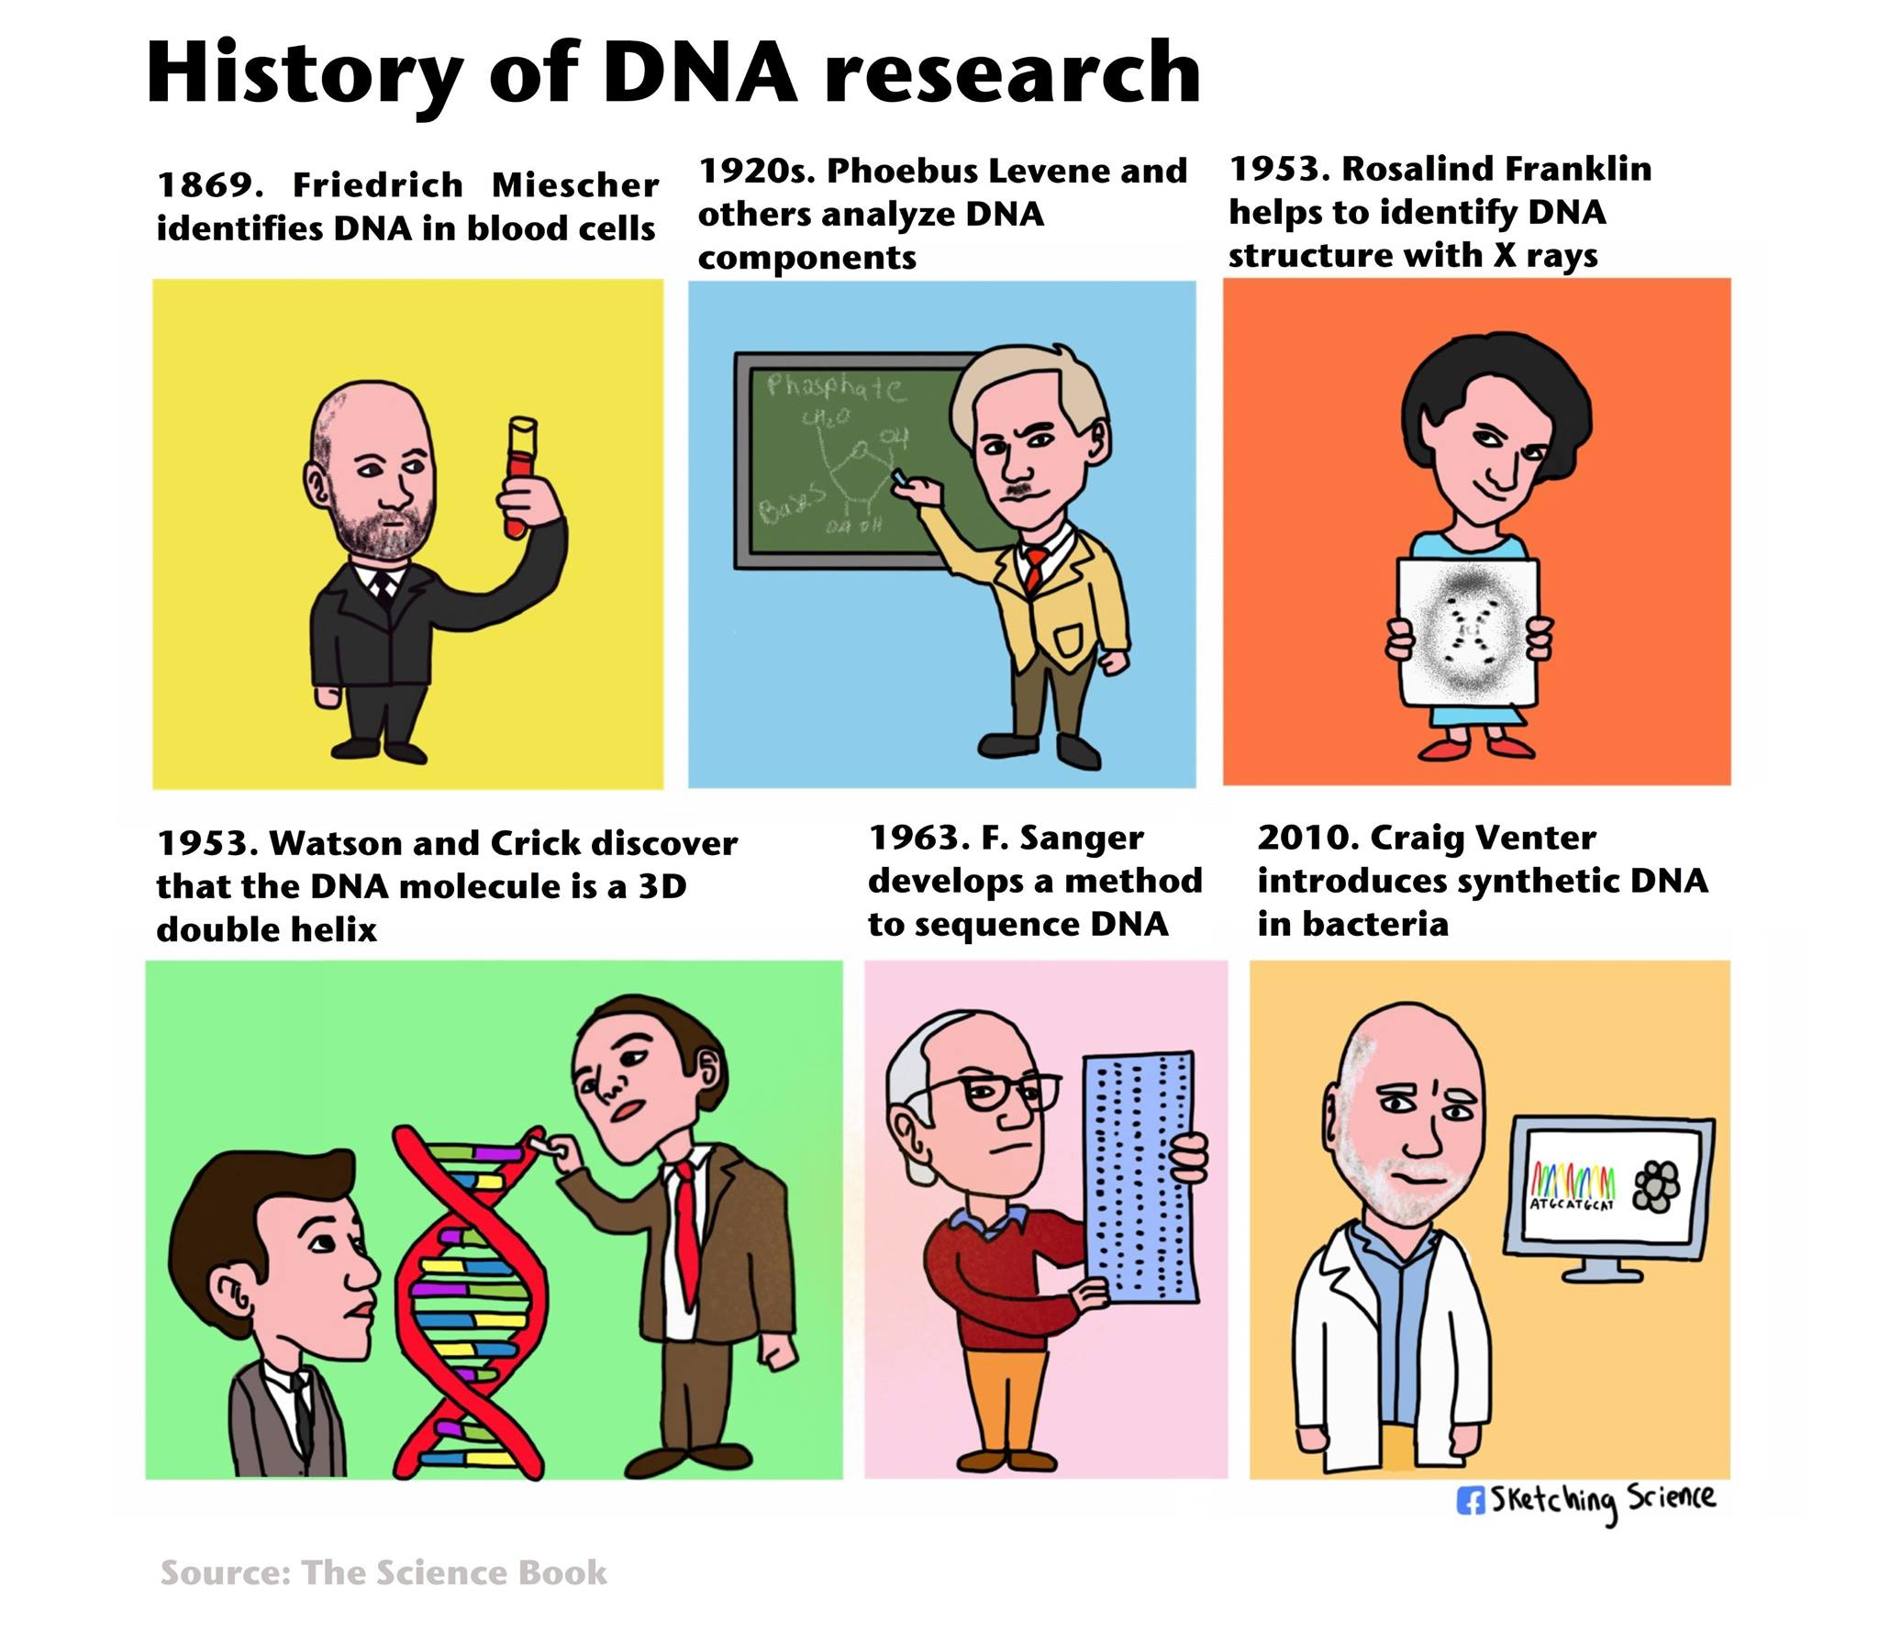

Slide 5
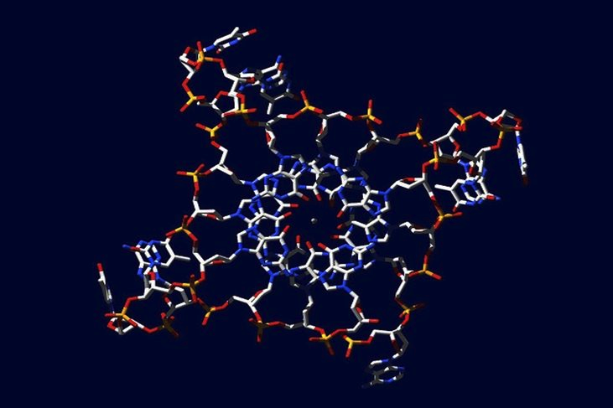
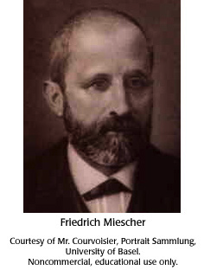
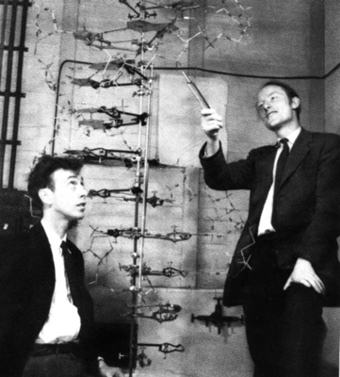
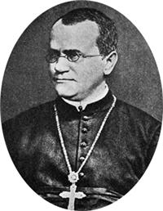
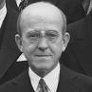
Founding Milestones in Genetics
Gregor
Mendel
1866
Friedrich
Miescher
1871
Oswald T. Avery
1944
Watson &Crick
1953
identified DNA as a distinct molecule
Double helix structure of DNA
DNA is hereditary material
Genetics
Green E, NHGRI
Notes:
Étapes importantes de la findatin de la génétique

Slide 6
The central dogma of molecular biology revisited
TATTTGATTTTTTGCTTAATTTTTATGTAATTACTTCCCCACAATTTTTGCCCACATATTGTGGATAAAT
ACCTTTAATCTAGAAATTACAATGAATGTTGTTGAAGAAGCACTTGGTGCTGTATTAAAAACTAAGAAGA
TTTCCACATTTTATTCACAATGTTGATAAGTTGTGTAAGTCGACTTGTTGGCTTTATAAAGCAAATGACA
CACTGAAAGTTATCCACAAACAAATTTTTCAAAAGTGTTTAAATCAAAAAGTTATCCACAAATAATGTGG
AAAACTTTTTAATAAATTTGTCGTTTCTTATGCTATCATAGTTTTACATAAATTATTAACTACTATAGGG
AGGCAGTCATGAGTCCAAACAGCACATTATGGCAGACAATATTACAGGATTTAGAAAAACTATACAACGA
GGAGACTTACAACGAGCTATTTCTACCAGTGACTTCTACTTTTAAAGATCAAAACGGATTACTTACAATG
GTTGTAGCTAATGAGTTCTTAAAGAATCGTATCAATAAACTATACATTGCAAAAATTAACGAACTTGCTA
CAAAATATTCAAGTACTCCAGTTAGATTGAAATTCGTATCACAAGAAGAAGTTATTGAAGAACCAGTAGC
TGATCGTAAATTAACCATTGATTATCGTCAAGGGAACTTAAACTCTACCTATACCTTTGACTCTTTTGTT
GTTGGAAAATCTAACATGTTTGCTTTTCGTATGGCGATGAAGGTTGCTGATCAACCTGGAGCAGTAGCAA
ACCCTTTCTACATATTTGGTGATGTAGGTTTAGGTAAAACCCATCTTATGCAAGCAATAGGTAACTATAT
ATTAGATAATGATGTCGAAAAACGTATCTTATATGTTAAAGCTGATAACTTTATTGAAGACTTTGTATCT
TTATTATCAAGAAACAAAAATAAGACTGAAGAATTCAATGCTAAATATAAAGATATTGACGTTATATTAG
TAGACGACATCCAAATTATGGCAAATGCTAGTAAAACTCAAATGGAATTCTTTAAGCTCTTTGACTACCT
ATATTTAAATAATAAACAAATCGTTATAACATCTGATAAACCAGCTTCACAATTAACAAATATCATGCCA
CGTTTAACGACACGTTTTGAAGCTGGTCTCTCTGTAGACATACAAATACCTGAATTAGAACATAGAATAA
GTATTTTAAAGAGAAAAACAGCTACATTAGATGCCAACTTAGAGGTAAGTGAGGATATTTTAACCTTTAT
AGCATCTCAATTTGCAGCAAACATTAGAGAAATGGAAGGTGCACTCATTCGTTTAATTAGTTATGCACAG
ACCTTTAATCTAGAAATTACAATGAATGTTGTTGAAGAAGCACTTGGTGCTGTATTAAAAACTAAGAAGA
AAACAAATGATTTAAACGAAAATAACTACGATAAGATCCAAAGTATTGTAGCAGATTACTTCCAAGTTTC
ATTACCAGACTTAATTGGTAAGAAAAGACATGCTAAATTCACATTACCTAGACATATAGCGATGTATCTT
ATTAAACTTAAATACAATATTCCTTATAAAACAATTGGATCTTTATTTAATGATAGAGACCACTCCACAG
TATTATCTGCTTGTGAAAAAGTAGAACGCGATATGAGGATGGATTCGAACTTAAAGTTTGCTGTTGACTC
GATTGTCAAAAAAATAGATTCACCATTATTAAAGTGATAAATGTTTATAAAAATGATTAAATGTGGTAAA
ATAAATGGTAGATGAAGCGATTATTGCTAGTTTCCCACTTTCCCACAGACACTAACAATAACAAAGAAGA
AATAATAATTAATAAAAGGGGTAAAATATGAATTTTACAATTGAAAGAGATATACGTTCAGTTAACCGGA
1953
2013
Replication
Replication
Genome
DNA
DNA
Genome
Transcription
Reverse transcription
Exon-shuffling
Transcription
Post-transcriptional regulations
Transcriptional regulations
Intermediary
RNA
RNA
Splicing, editing
non-coding RNAs
Translation
(genetic code)
Translation
(genetic code )
Proteins
Proteins
Bernard Dujon, 2013
http://www.pasteur.fr/~tekaia/BCGA2013/TALKS/Dujon_EukaryoticGenomesBasicPrinciples_BCGA2013.pdf

Slide 7
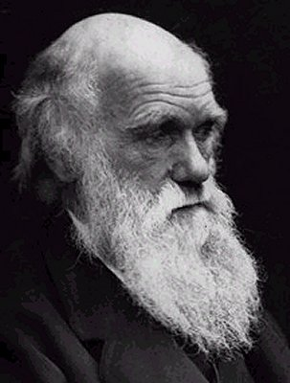
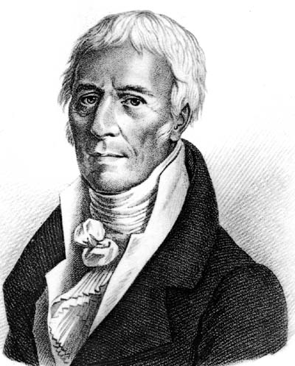
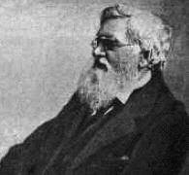
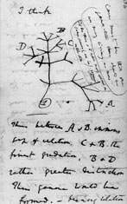
Early ideas of evolution
A response to environmental conditions of living organisms is diversification and specialization (speciation).
Charles Robert Darwin
(1809-1882)
Alfred Russell Wallace
(1823-1913)
Jean-Baptiste de Monet,
chevalier de Lamarck
(1744-1829)
best known for independently conceived the theory of evolution through natural selection
early proponent of the idea that evolution occurred and proceeded in accordance with natural laws
origin of species
Co-founder of evolutionary biology
Notes:
Lamarck: early proponent of the idea that evolution occurred and proceeded in accordance with natural laws.
Darwin: origin of species.
Alfred Russel Wallace: is best known for independently conceived the theory of evolution through natural selection.

Slide 8
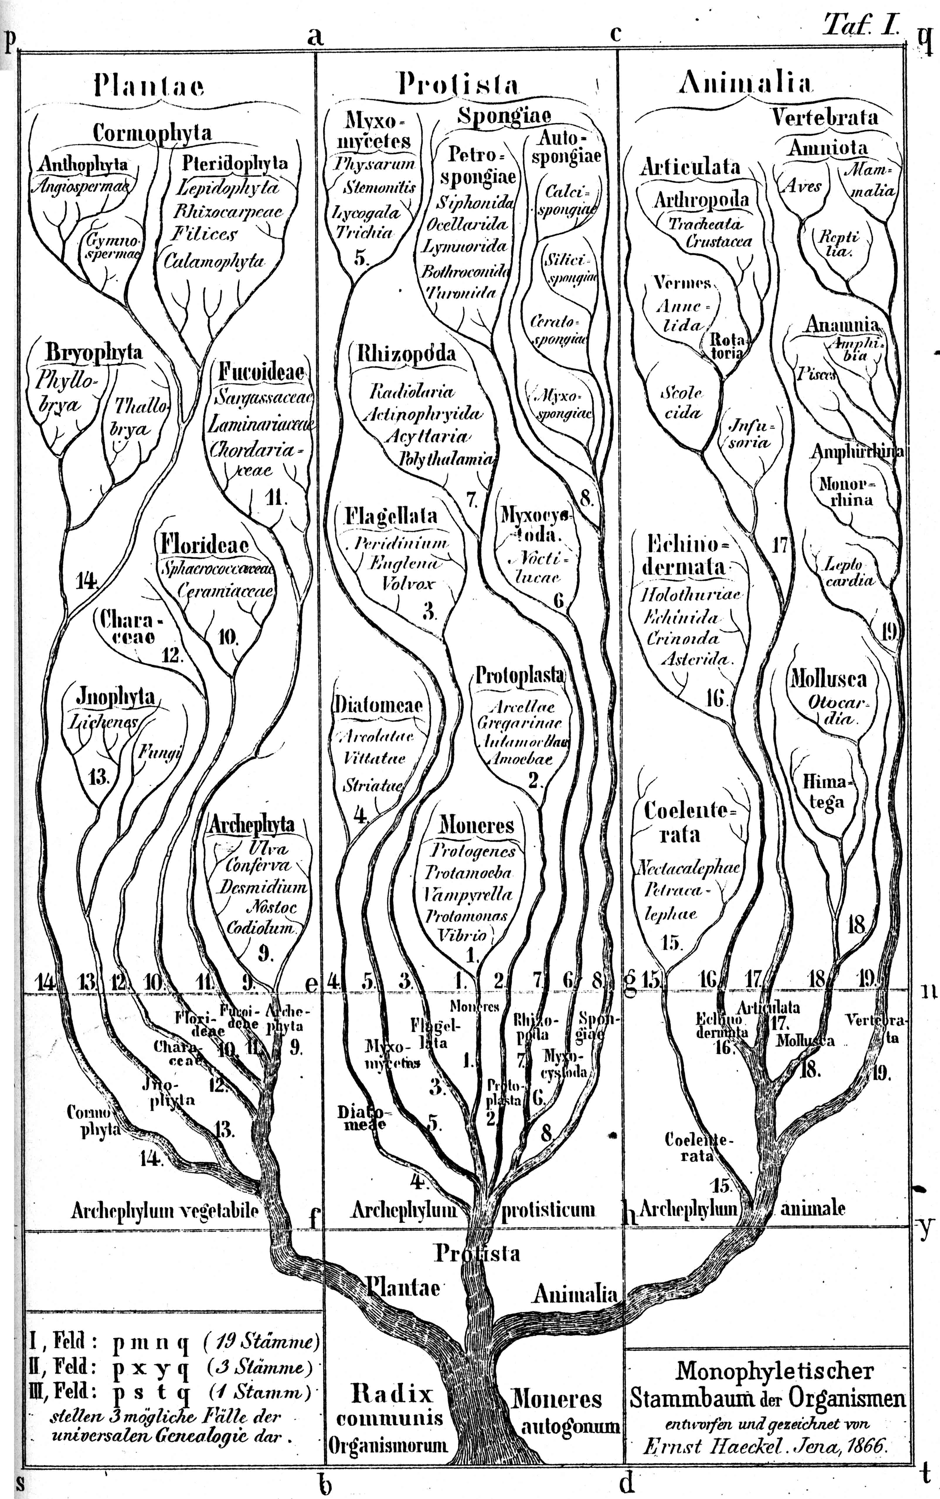
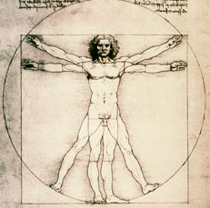
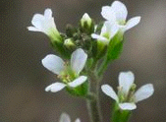
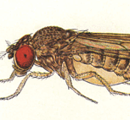
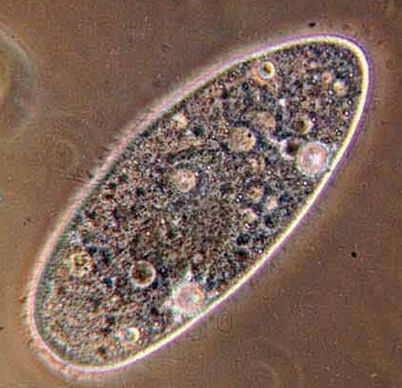
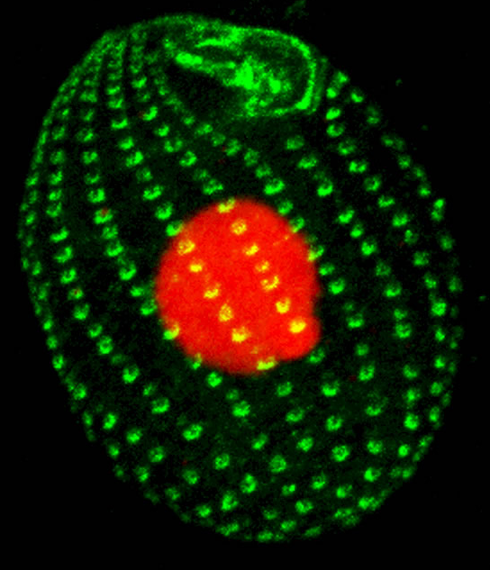
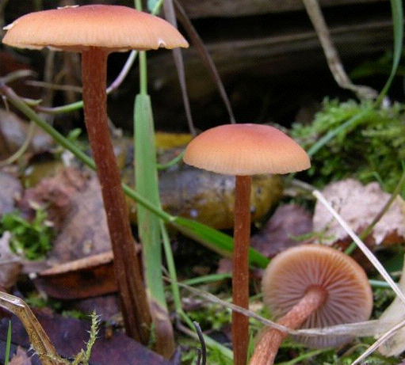
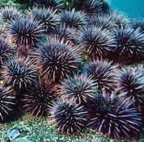
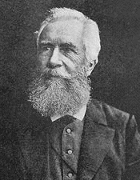
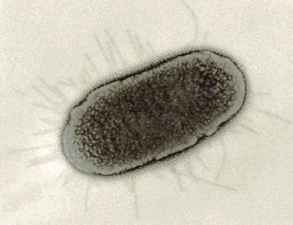
Ernst Heinrich Haeckel
(1834-1919)
1866

Slide 9
Founding ideas
"It is not the strongest of species that survives, nor the most intelligent. It is the one that is the most adaptable to change."
Charles Darwin (1809-1882)
"Nothing in Biology Makes Sense Except in the Light of Evolution."
Theodosius Dobzhansky (1900 - 1975)
Comparative Genomics
Notes:
Idées fondatrice

Slide 10
TATTTGATTTTTTGCTTAATTTTTATGTAATTACTTCCCCACAATTTTTGCCCACATATTGTGGATAAAT
ACCTTTAATCTAGAAATTACAATGAATGTTGTTGAAGAAGCACTTGGTGCTGTATTAAAAACTAAGAAGA
TTTCCACATTTTATTCACAATGTTGATAAGTTGTGTAAGTCGACTTGTTGGCTTTATAAAGCAAATGACA
CACTGAAAGTTATCCACAAACAAATTTTTCAAAAGTGTTTAAATCAAAAAGTTATCCACAAATAATGTGG
AAAACTTTTTAATAAATTTGTCGTTTCTTATGCTATCATAGTTTTACATAAATTATTAACTACTATAGGG
AGGCAGTCATGAGTCCAAACAGCACATTATGGCAGACAATATTACAGGATTTAGAAAAACTATACAACGA
GGAGACTTACAACGAGCTATTTCTACCAGTGACTTCTACTTTTAAAGATCAAAACGGATTACTTACAATG
GTTGTAGCTAATGAGTTCTTAAAGAATCGTATCAATAAACTATACATTGCAAAAATTAACGAACTTGCTA
CAAAATATTCAAGTACTCCAGTTAGATTGAAATTCGTATCACAAGAAGAAGTTATTGAAGAACCAGTAGC
TGATCGTAAATTAACCATTGATTATCGTCAAGGGAACTTAAACTCTACCTATACCTTTGACTCTTTTGTT
GTTGGAAAATCTAACATGTTTGCTTTTCGTATGGCGATGAAGGTTGCTGATCAACCTGGAGCAGTAGCAA
ACCCTTTCTACATATTTGGTGATGTAGGTTTAGGTAAAACCCATCTTATGCAAGCAATAGGTAACTATAT
ATTAGATAATGATGTCGAAAAACGTATCTTATATGTTAAAGCTGATAACTTTATTGAAGACTTTGTATCT
TTATTATCAAGAAACAAAAATAAGACTGAAGAATTCAATGCTAAATATAAAGATATTGACGTTATATTAG
TAGACGACATCCAAATTATGGCAAATGCTAGTAAAACTCAAATGGAATTCTTTAAGCTCTTTGACTACCT
ATATTTAAATAATAAACAAATCGTTATAACATCTGATAAACCAGCTTCACAATTAACAAATATCATGCCA
CGTTTAACGACACGTTTTGAAGCTGGTCTCTCTGTAGACATACAAATACCTGAATTAGAACATAGAATAA
GTATTTTAAAGAGAAAAACAGCTACATTAGATGCCAACTTAGAGGTAAGTGAGGATATTTTAACCTTTAT
AGCATCTCAATTTGCAGCAAACATTAGAGAAATGGAAGGTGCACTCATTCGTTTAATTAGTTATGCACAG
ACCTTTAATCTAGAAATTACAATGAATGTTGTTGAAGAAGCACTTGGTGCTGTATTAAAAACTAAGAAGA
AAACAAATGATTTAAACGAAAATAACTACGATAAGATCCAAAGTATTGTAGCAGATTACTTCCAAGTTTC
ATTACCAGACTTAATTGGTAAGAAAAGACATGCTAAATTCACATTACCTAGACATATAGCGATGTATCTT
ATTAAACTTAAATACAATATTCCTTATAAAACAATTGGATCTTTATTTAATGATAGAGACCACTCCACAG
TATTATCTGCTTGTGAAAAAGTAGAACGCGATATGAGGATGGATTCGAACTTAAAGTTTGCTGTTGACTC
GATTGTCAAAAAAATAGATTCACCATTATTAAAGTGATAAATGTTTATAAAAATGATTAAATGTGGTAAA
ATAAATGGTAGATGAAGCGATTATTGCTAGTTTCCCACTTTCCCACAGACACTAACAATAACAAAGAAGA
AATAATAATTAATAAAAGGGGTAAAATATGAATTTTACAATTGAAAGAGATATACGTTCAGTTAACCGGA
Genome
The genome of a cell is the complete genetic material which is contained in its chromosome(s).
It is the full DNA sequence of the cell.
The genome size is the total of its DNA bases.
Gene
Is a particular DNA sequence situated in a specific position on a chromosome and that codes for a specific function.
Protein
Is a sequence made up of amino-acids ordered according to the DNA sequence of the gene it codes for.
Proteome
Is the set of proteins in an organism.

Slide 11
What is a gene ?
Genetic definition
Region of genome that contains all the information required for synthesis of a product (protein or RNA)
Includes both coding and non-coding sequences
Working definition
Region of genome that encodes a potential protein
CDS (coding sequence)
Peter Myler

Slide 12
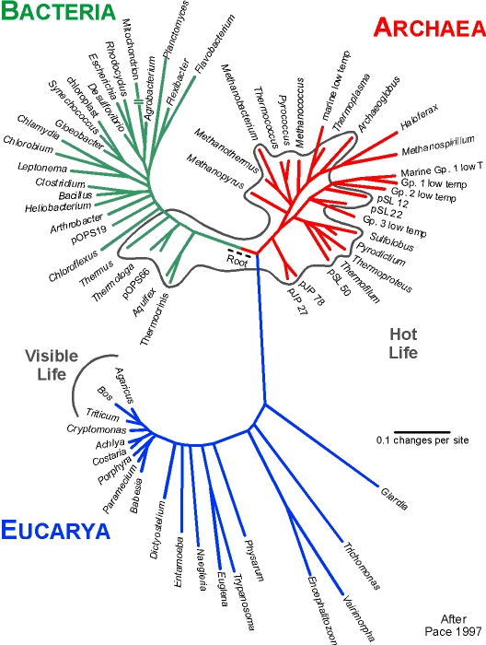
11/10/2017
TATTTGATTTTTTGCTTAATTTTTATGTAATTACTTCCCCACAATTTTTGCCCACATATTGTGGATAAAT
ACCTTTAATCTAGAAATTACAATGAATGTTGTTGAAGAAGCACTTGGTGCTGTATTAAAAACTAAGAAGA
TTTCCACATTTTATTCACAATGTTGATAAGTTGTGTAAGTCGACTTGTTGGCTTTATAAAGCAAATGACA
CACTGAAAGTTATCCACAAACAAATTTTTCAAAAGTGTTTAAATCAAAAAGTTATCCACAAATAATGTGG
AAAACTTTTTAATAAATTTGTCGTTTCTTATGCTATCATAGTTTTACATAAATTATTAACTACTATAGGG
AGGCAGTCATGAGTCCAAACAGCACATTATGGCAGACAATATTACAGGATTTAGAAAAACTATACAACGA
GGAGACTTACAACGAGCTATTTCTACCAGTGACTTCTACTTTTAAAGATCAAAACGGATTACTTACAATG
GTTGTAGCTAATGAGTTCTTAAAGAATCGTATCAATAAACTATACATTGCAAAAATTAACGAACTTGCTA
CAAAATATTCAAGTACTCCAGTTAGATTGAAATTCGTATCACAAGAAGAAGTTATTGAAGAACCAGTAGC
TGATCGTAAATTAACCATTGATTATCGTCAAGGGAACTTAAACTCTACCTATACCTTTGACTCTTTTGTT
GTTGGAAAATCTAACATGTTTGCTTTTCGTATGGCGATGAAGGTTGCTGATCAACCTGGAGCAGTAGCAA
ACCCTTTCTACATATTTGGTGATGTAGGTTTAGGTAAAACCCATCTTATGCAAGCAATAGGTAACTATAT
ATTAGATAATGATGTCGAAAAACGTATCTTATATGTTAAAGCTGATAACTTTATTGAAGACTTTGTATCT
TTATTATCAAGAAACAAAAATAAGACTGAAGAATTCAATGCTAAATATAAAGATATTGACGTTATATTAG
TAGACGACATCCAAATTATGGCAAATGCTAGTAAAACTCAAATGGAATTCTTTAAGCTCTTTGACTACCT
ATATTTAAATAATAAACAAATCGTTATAACATCTGATAAACCAGCTTCACAATTAACAAATATCATGCCA
CGTTTAACGACACGTTTTGAAGCTGGTCTCTCTGTAGACATACAAATACCTGAATTAGAACATAGAATAA
GTATTTTAAAGAGAAAAACAGCTACATTAGATGCCAACTTAGAGGTAAGTGAGGATATTTTAACCTTTAT
AGCATCTCAATTTGCAGCAAACATTAGAGAAATGGAAGGTGCACTCATTCGTTTAATTAGTTATGCACAG
ACCTTTAATCTAGAAATTACAATGAATGTTGTTGAAGAAGCACTTGGTGCTGTATTAAAAACTAAGAAGA
AAACAAATGATTTAAACGAAAATAACTACGATAAGATCCAAAGTATTGTAGCAGATTACTTCCAAGTTTC
ATTACCAGACTTAATTGGTAAGAAAAGACATGCTAAATTCACATTACCTAGACATATAGCGATGTATCTT
ATTAAACTTAAATACAATATTCCTTATAAAACAATTGGATCTTTATTTAATGATAGAGACCACTCCACAG
TATTATCTGCTTGTGAAAAAGTAGAACGCGATATGAGGATGGATTCGAACTTAAAGTTTGCTGTTGACTC
GATTGTCAAAAAAATAGATTCACCATTATTAAAGTGATAAATGTTTATAAAAATGATTAAATGTGGTAAA
ATAAATGGTAGATGAAGCGATTATTGCTAGTTTCCCACTTTCCCACAGACACTAACAATAACAAAGAAGA
AATAATAATTAATAAAAGGGGTAAAATATGAATTTTACAATTGAAAGAGATATACGTTCAGTTAACCGGA
Complete sequenced genomes: 8319
• 7656 Bacteria
• 258 Archaea
• 405 Eukaryotes
7656
258
Total projects: 11 000
Incomplete genomes: 15462
• 10682 Bacteria
• 294 Archaea
• 4886 Eukaryotes
Tree of life
Permanent Draft genomes: 70185
• 65162 Bacteria
• 779 Archaea
• 4244 Eukaryotes
405
Transciptomes: 73/9302
• 51/1017 Bacteria
• 0/160 Archaea
• 24/13220 Eukaryota
https://gold.jgi.doe.gov
Viruses: • Completed: 3504 • Permanent draft: 4450
Notes:
Most accepted structure today: leaving species are classified into 3 domains
Still many attempts to introduce new branches or tree forms
Or even new organizations

Slide 13
Bacteria: Phylum distribution of 7656 completely sequenced genomes

Slide 14
Bacteria: Phylum distribution of 10682 Incompletely sequenced genomes

Slide 15
Eukaryotes: Phylum distribution of 405 completely sequenced genomes

Slide 16
Eukaryotes: Phylum distribution of 4486 Incompletely sequenced genomes

Slide 17
Eukaryotes: Phylum distribution of 5226 Incompletely transcriptome genomes

Slide 18
TATTTGATTTTTTGCTTAATTTTTATGTAATTACTTCCCCACAATTTTTGCCCACATATTGTGGATAAAT
ACCTTTAATCTAGAAATTACAATGAATGTTGTTGAAGAAGCACTTGGTGCTGTATTAAAAACTAAGAAGA
TTTCCACATTTTATTCACAATGTTGATAAGTTGTGTAAGTCGACTTGTTGGCTTTATAAAGCAAATGACA
CACTGAAAGTTATCCACAAACAAATTTTTCAAAAGTGTTTAAATCAAAAAGTTATCCACAAATAATGTGG
AAAACTTTTTAATAAATTTGTCGTTTCTTATGCTATCATAGTTTTACATAAATTATTAACTACTATAGGG
AGGCAGTCATGAGTCCAAACAGCACATTATGGCAGACAATATTACAGGATTTAGAAAAACTATACAACGA
GGAGACTTACAACGAGCTATTTCTACCAGTGACTTCTACTTTTAAAGATCAAAACGGATTACTTACAATG
GTTGTAGCTAATGAGTTCTTAAAGAATCGTATCAATAAACTATACATTGCAAAAATTAACGAACTTGCTA
CAAAATATTCAAGTACTCCAGTTAGATTGAAATTCGTATCACAAGAAGAAGTTATTGAAGAACCAGTAGC
TGATCGTAAATTAACCATTGATTATCGTCAAGGGAACTTAAACTCTACCTATACCTTTGACTCTTTTGTT
GTTGGAAAATCTAACATGTTTGCTTTTCGTATGGCGATGAAGGTTGCTGATCAACCTGGAGCAGTAGCAA
ACCCTTTCTACATATTTGGTGATGTAGGTTTAGGTAAAACCCATCTTATGCAAGCAATAGGTAACTATAT
ATTAGATAATGATGTCGAAAAACGTATCTTATATGTTAAAGCTGATAACTTTATTGAAGACTTTGTATCT
TTATTATCAAGAAACAAAAATAAGACTGAAGAATTCAATGCTAAATATAAAGATATTGACGTTATATTAG
TAGACGACATCCAAATTATGGCAAATGCTAGTAAAACTCAAATGGAATTCTTTAAGCTCTTTGACTACCT
ATATTTAAATAATAAACAAATCGTTATAACATCTGATAAACCAGCTTCACAATTAACAAATATCATGCCA
CGTTTAACGACACGTTTTGAAGCTGGTCTCTCTGTAGACATACAAATACCTGAATTAGAACATAGAATAA
GTATTTTAAAGAGAAAAACAGCTACATTAGATGCCAACTTAGAGGTAAGTGAGGATATTTTAACCTTTAT
AGCATCTCAATTTGCAGCAAACATTAGAGAAATGGAAGGTGCACTCATTCGTTTAATTAGTTATGCACAG
ACCTTTAATCTAGAAATTACAATGAATGTTGTTGAAGAAGCACTTGGTGCTGTATTAAAAACTAAGAAGA
AAACAAATGATTTAAACGAAAATAACTACGATAAGATCCAAAGTATTGTAGCAGATTACTTCCAAGTTTC
ATTACCAGACTTAATTGGTAAGAAAAGACATGCTAAATTCACATTACCTAGACATATAGCGATGTATCTT
ATTAAACTTAAATACAATATTCCTTATAAAACAATTGGATCTTTATTTAATGATAGAGACCACTCCACAG
TATTATCTGCTTGTGAAAAAGTAGAACGCGATATGAGGATGGATTCGAACTTAAAGTTTGCTGTTGACTC
GATTGTCAAAAAAATAGATTCACCATTATTAAAGTGATAAATGTTTATAAAAATGATTAAATGTGGTAAA
ATAAATGGTAGATGAAGCGATTATTGCTAGTTTCCCACTTTCCCACAGACACTAACAATAACAAAGAAGA
AATAATAATTAATAAAAGGGGTAAAATATGAATTTTACAATTGAAAGAGATATACGTTCAGTTAACCGGA
Chronology of completely sequenced genomes: Historical landmarks

Slide 19
First Sequence
• The sequencing of the first protein was achieved by Frederic Sanger in 1953.
He determined the amino acid sequence of
bovine insulin
• Wu and Kaiser published the first successful DNA sequence of the bacteriophage lambda in 1968.
The early days of DNA sequences.Sanger F.Nat Med. 2001 Mar;7(3):267-8.

Slide 20
First completely sequenced genomes

Slide 21
1976
Complete sequence of the viral RNA genome of a bacteriophage MS2 (Walter Fiers et al. 3569 bp).
Viral genome (5368 base pairs; encoding 11 genes). Sanger et al. sequence bacteriophage φX174.
1977
Human mitochondrial genome 16,500 base pairs (encodes 13 proteins, 2 rRNA, 22 tRNA)(Sanger et al.)
1981
1984
Complete sequence of the HIV-1 genome was determined (9749bp).
1986
Chloroplast genome 156,000 base pairs
Notes:
Note: Some early milestones in protein and peptide sequencing
In Joel B Hagen : Nature Reviews Genetics 1, 231-236 (December 2000) | doi:10.1038/35042090

Slide 22
First genome of a free-living organism, the bacterium Haemophilus influenzae, by TIGR, 1830 Kb, 1713 genes.
1995
Starting year of Genomics
First genome of an archaeal genome: Methanococcus jannaschii DSM 2661, by TIGR, 1664 Kb, 1773 genes.
1996
First eukaryotic genome : Saccharomyces cerevisiae S288C; International collaboration; 16 Chromosomes; 12,057 Mb, ~6000 genes.
1997
First multicellular organism. Nematode Caenorhabditis elegans; 97 Mb; ~19,000 genes.
1998

Slide 23
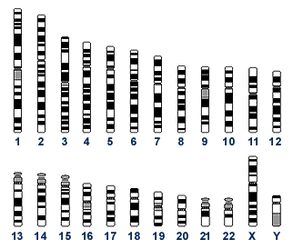
1999: first human chromosome: Chromosome 22
(49 Mb, 673 genes)
TATTTGATTTTTTGCTTAATTTTTATGTAATTACTTCCCCACAATTTTTGCCCACATATTGTGGATAAAT
ACCTTTAATCTAGAAATTACAATGAATGTTGTTGAAGAAGCACTTGGTGCTGTATTAAAAACTAAGAAGA
TTTCCACATTTTATTCACAATGTTGATAAGTTGTGTAAGTCGACTTGTTGGCTTTATAAAGCAAATGACA
CACTGAAAGTTATCCACAAACAAATTTTTCAAAAGTGTTTAAATCAAAAAGTTATCCACAAATAATGTGG
AAAACTTTTTAATAAATTTGTCGTTTCTTATGCTATCATAGTTTTACATAAATTATTAACTACTATAGGG
AGGCAGTCATGAGTCCAAACAGCACATTATGGCAGACAATATTACAGGATTTAGAAAAACTATACAACGA
GGAGACTTACAACGAGCTATTTCTACCAGTGACTTCTACTTTTAAAGATCAAAACGGATTACTTACAATG
GTTGTAGCTAATGAGTTCTTAAAGAATCGTATCAATAAACTATACATTGCAAAAATTAACGAACTTGCTA
CAAAATATTCAAGTACTCCAGTTAGATTGAAATTCGTATCACAAGAAGAAGTTATTGAAGAACCAGTAGC
TGATCGTAAATTAACCATTGATTATCGTCAAGGGAACTTAAACTCTACCTATACCTTTGACTCTTTTGTT
GTTGGAAAATCTAACATGTTTGCTTTTCGTATGGCGATGAAGGTTGCTGATCAACCTGGAGCAGTAGCAA
ACCCTTTCTACATATTTGGTGATGTAGGTTTAGGTAAAACCCATCTTATGCAAGCAATAGGTAACTATAT
ATTAGATAATGATGTCGAAAAACGTATCTTATATGTTAAAGCTGATAACTTTATTGAAGACTTTGTATCT
TTATTATCAAGAAACAAAAATAAGACTGAAGAATTCAATGCTAAATATAAAGATATTGACGTTATATTAG
TAGACGACATCCAAATTATGGCAAATGCTAGTAAAACTCAAATGGAATTCTTTAAGCTCTTTGACTACCT
ATATTTAAATAATAAACAAATCGTTATAACATCTGATAAACCAGCTTCACAATTAACAAATATCATGCCA
CGTTTAACGACACGTTTTGAAGCTGGTCTCTCTGTAGACATACAAATACCTGAATTAGAACATAGAATAA
GTATTTTAAAGAGAAAAACAGCTACATTAGATGCCAACTTAGAGGTAAGTGAGGATATTTTAACCTTTAT
AGCATCTCAATTTGCAGCAAACATTAGAGAAATGGAAGGTGCACTCATTCGTTTAATTAGTTATGCACAG
ACCTTTAATCTAGAAATTACAATGAATGTTGTTGAAGAAGCACTTGGTGCTGTATTAAAAACTAAGAAGA
AAACAAATGATTTAAACGAAAATAACTACGATAAGATCCAAAGTATTGTAGCAGATTACTTCCAAGTTTC
ATTACCAGACTTAATTGGTAAGAAAAGACATGCTAAATTCACATTACCTAGACATATAGCGATGTATCTT
ATTAAACTTAAATACAATATTCCTTATAAAACAATTGGATCTTTATTTAATGATAGAGACCACTCCACAG
TATTATCTGCTTGTGAAAAAGTAGAACGCGATATGAGGATGGATTCGAACTTAAAGTTTGCTGTTGACTC
GATTGTCAAAAAAATAGATTCACCATTATTAAAGTGATAAATGTTTATAAAAATGATTAAATGTGGTAAA
ATAAATGGTAGATGAAGCGATTATTGCTAGTTTCCCACTTTCCCACAGACACTAACAATAACAAAGAAGA
AATAATAATTAATAAAAGGGGTAAAATATGAATTTTACAATTGAAAGAGATATACGTTCAGTTAACCGGA

Slide 24
Fruitfly Drosophila melanogaster (137 Mb; ~13,000 genes)
2000
First plant genome: Arabidopsis thaliana (115,428 Mb; 22670 genes
draft sequence of the human genome (~3000 Mb; ~28000 genes!) actually ~23000 genes.
2001
plasmodium falciparum (22,9 Mb; 5334 genes)
2002
mouse genome (2,651 Mb; ~28000 genes)
Fish draft Tetraodon nigroviridis genome (342,403 Mb; ~28000 genes)
2004
2005
Dog (41Mb, 33651 genes) and chicken genomes ( 18031 genes)

Slide 25
TATTTGATTTTTTGCTTAATTTTTATGTAATTACTTCCCCACAATTTTTGCCCACATATTGTGGATAAAT
ACCTTTAATCTAGAAATTACAATGAATGTTGTTGAAGAAGCACTTGGTGCTGTATTAAAAACTAAGAAGA
TTTCCACATTTTATTCACAATGTTGATAAGTTGTGTAAGTCGACTTGTTGGCTTTATAAAGCAAATGACA
CACTGAAAGTTATCCACAAACAAATTTTTCAAAAGTGTTTAAATCAAAAAGTTATCCACAAATAATGTGG
AAAACTTTTTAATAAATTTGTCGTTTCTTATGCTATCATAGTTTTACATAAATTATTAACTACTATAGGG
AGGCAGTCATGAGTCCAAACAGCACATTATGGCAGACAATATTACAGGATTTAGAAAAACTATACAACGA
GGAGACTTACAACGAGCTATTTCTACCAGTGACTTCTACTTTTAAAGATCAAAACGGATTACTTACAATG
GTTGTAGCTAATGAGTTCTTAAAGAATCGTATCAATAAACTATACATTGCAAAAATTAACGAACTTGCTA
CAAAATATTCAAGTACTCCAGTTAGATTGAAATTCGTATCACAAGAAGAAGTTATTGAAGAACCAGTAGC
TGATCGTAAATTAACCATTGATTATCGTCAAGGGAACTTAAACTCTACCTATACCTTTGACTCTTTTGTT
GTTGGAAAATCTAACATGTTTGCTTTTCGTATGGCGATGAAGGTTGCTGATCAACCTGGAGCAGTAGCAA
ACCCTTTCTACATATTTGGTGATGTAGGTTTAGGTAAAACCCATCTTATGCAAGCAATAGGTAACTATAT
ATTAGATAATGATGTCGAAAAACGTATCTTATATGTTAAAGCTGATAACTTTATTGAAGACTTTGTATCT
TTATTATCAAGAAACAAAAATAAGACTGAAGAATTCAATGCTAAATATAAAGATATTGACGTTATATTAG
TAGACGACATCCAAATTATGGCAAATGCTAGTAAAACTCAAATGGAATTCTTTAAGCTCTTTGACTACCT
ATATTTAAATAATAAACAAATCGTTATAACATCTGATAAACCAGCTTCACAATTAACAAATATCATGCCA
CGTTTAACGACACGTTTTGAAGCTGGTCTCTCTGTAGACATACAAATACCTGAATTAGAACATAGAATAA
GTATTTTAAAGAGAAAAACAGCTACATTAGATGCCAACTTAGAGGTAAGTGAGGATATTTTAACCTTTAT
AGCATCTCAATTTGCAGCAAACATTAGAGAAATGGAAGGTGCACTCATTCGTTTAATTAGTTATGCACAG
ACCTTTAATCTAGAAATTACAATGAATGTTGTTGAAGAAGCACTTGGTGCTGTATTAAAAACTAAGAAGA
AAACAAATGATTTAAACGAAAATAACTACGATAAGATCCAAAGTATTGTAGCAGATTACTTCCAAGTTTC
ATTACCAGACTTAATTGGTAAGAAAAGACATGCTAAATTCACATTACCTAGACATATAGCGATGTATCTT
ATTAAACTTAAATACAATATTCCTTATAAAACAATTGGATCTTTATTTAATGATAGAGACCACTCCACAG
TATTATCTGCTTGTGAAAAAGTAGAACGCGATATGAGGATGGATTCGAACTTAAAGTTTGCTGTTGACTC
GATTGTCAAAAAAATAGATTCACCATTATTAAAGTGATAAATGTTTATAAAAATGATTAAATGTGGTAAA
ATAAATGGTAGATGAAGCGATTATTGCTAGTTTCCCACTTTCCCACAGACACTAACAATAACAAAGAAGA
AATAATAATTAATAAAAGGGGTAAAATATGAATTTTACAATTGAAAGAGATATACGTTCAGTTAACCGGA
2010
Family whole genomes:
Whole-genome sequences of a family of four, consisting of two siblings and their parents.
(Analysis of Genetic Inheritance in a Family Quartet by Whole-Genome Sequencing.
Jared C. Roach, et al. Science 328, 636 (2010))
=> Family-based genome analysis enabled to narrow the candidate genes for two Mendelian disorders (Miller syndrome, primary ciliary dyskinesia) to only four genes.

Slide 26
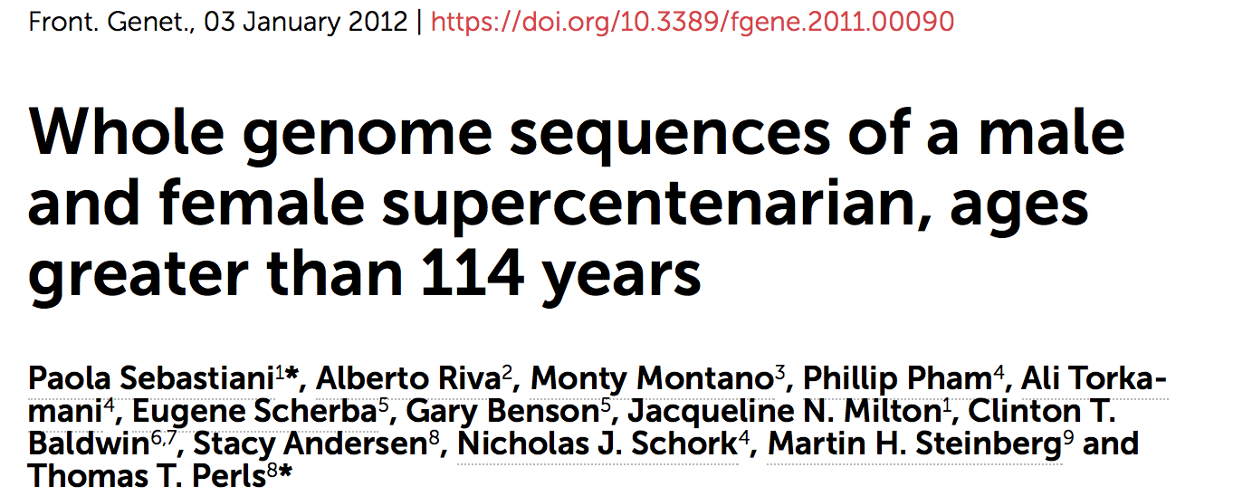
2012
=> These analyses suggest that there are both common and rare longevity-associated variants that may counter the effects of disease-predisposing variants and extend lifespan.

Slide 27
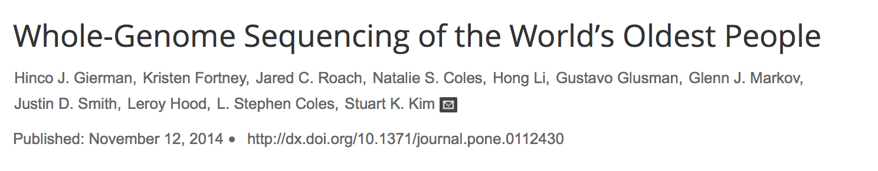
2014
74 Supercentenarians (110 years or older) are alive worldwide, with 22 in the United States.
Whole-genome sequencing was performed on 17 supercentenarians to explore the genetic basis underlying extreme human longevity.
No significant evidence of enrichment for a single rare protein-altering variant or for a gene harboring different rare protein altering variants in supercentenarian compared to control genomes.

Slide 28
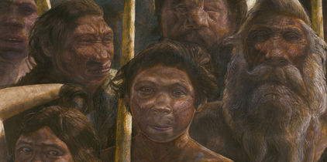
Ancient DNA sequencing

Slide 29
Ancient DNA sequencing
Ancient DNA studies are used to address three broad issues:
• The estimation of molecular rates of change using serially preserved samples;
• The testing of specific evolutionary hypotheses;
• The estimation of changes in genetic diversity and population sizes through time.

Slide 30
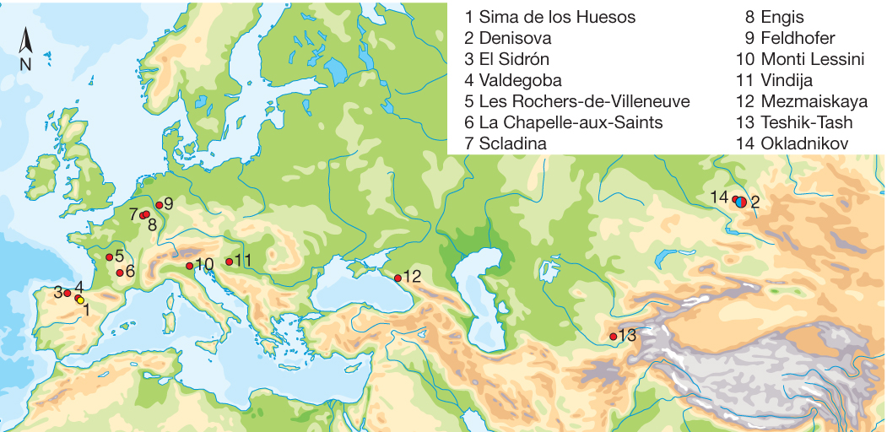

Location of the Middle Pleistocene site of Sima de los Huesos (yellow) as
well as Late Pleistocene sites that have yielded Neanderthal DNA
(red) and Denisovan DNA (blue).
• 2013
M Meyer et al. Nature 000, 1-4 (2013) doi:10.1038/nature12788
A mitochondrial genome sequence of a hominin from Sima de los Huesos

Slide 31
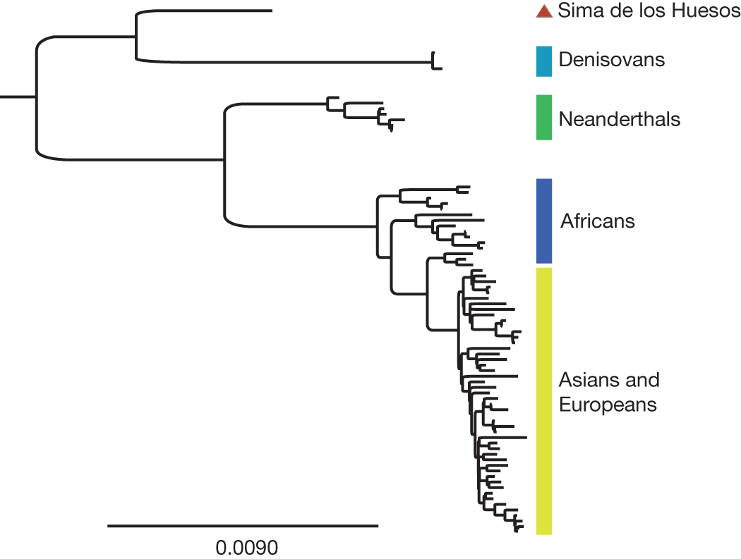
• 2013
Bayesian phylogenetic tree of hominin mitochondrial relationships based
on the Sima de los Huesos mtDNA sequence determined
using the inclusive filtering criteria.
Oldest hominin sequence:
400 000 years ago
M Meyer et al. Nature 000, 1-4 (2013) doi:10.1038/nature12788
A mitochondrial genome sequence of a hominin from Sima de los Huesos

Slide 32
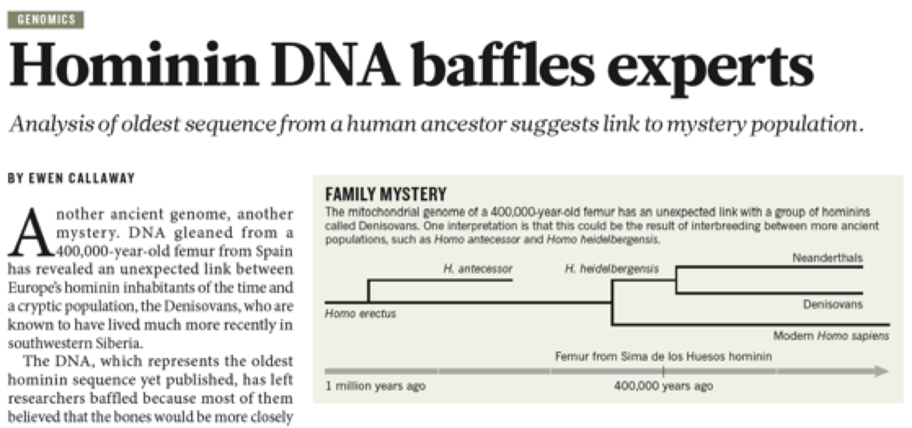
• 2013
400 000 years ago
Callaway e. Nature 504, 16-17. 5 December, 2013.
Recently (2016):
Nuclear DNA sequences from two specimens were recovered, which show that the Sima de los Huesos hominins were related to Neanderthals rather than to Denisovans, indicating that the population divergence between Neanderthals and Denisovans predates 430,000 years ago.
Meyer M, et al.Nature. 2016 Mar 14. Nuclear DNA sequences from the Middle Pleistocene Sima de los Huesos hominins.

Slide 33
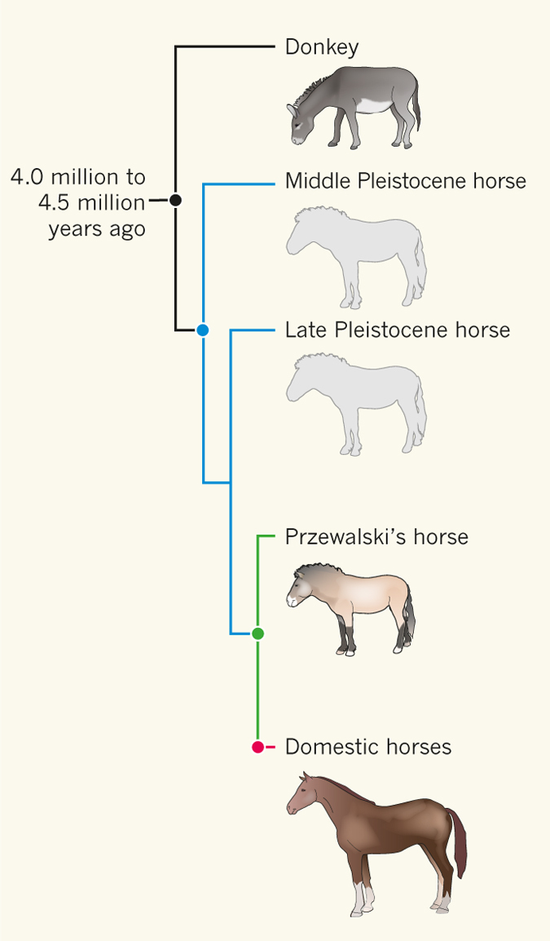
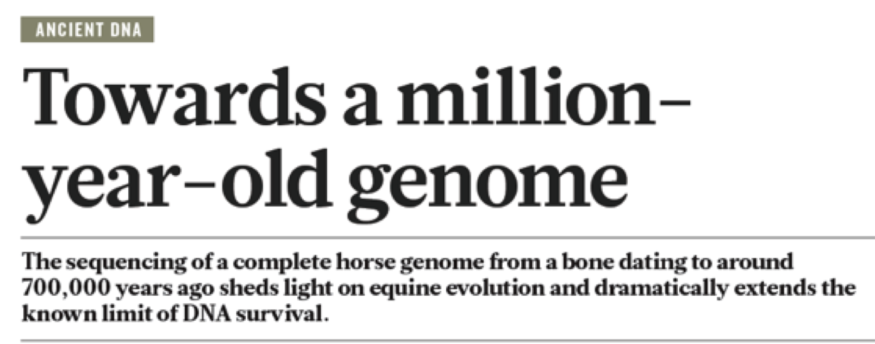
• 2013
Ancient DNA: Towards a million-year-old genome.
Millar CD, Lambert DM.Nature. 2013 499:34-5.
Recalibrating Equus evolution using the genome sequence of an early Middle Pleistocene horse. Orlando et al. Nature 2013. 29:1682-4.
Notes:
In this issue, Orlando et al.2 (page 74) address the latter two concepts in their report of the complete genome sequence of a horse that lived around 700,000 years ago. This genome is almost 10 times older than the previous record, which was for a Denisovan3, an archaic human dated at approximately 80,000 years before present*.

Slide 34
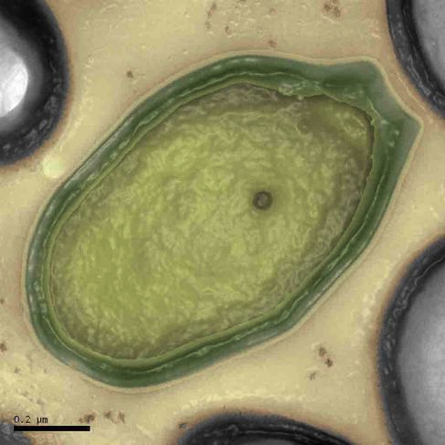
TATTTGATTTTTTGCTTAATTTTTATGTAATTACTTCCCCACAATTTTTGCCCACATATTGTGGATAAAT
ACCTTTAATCTAGAAATTACAATGAATGTTGTTGAAGAAGCACTTGGTGCTGTATTAAAAACTAAGAAGA
TTTCCACATTTTATTCACAATGTTGATAAGTTGTGTAAGTCGACTTGTTGGCTTTATAAAGCAAATGACA
CACTGAAAGTTATCCACAAACAAATTTTTCAAAAGTGTTTAAATCAAAAAGTTATCCACAAATAATGTGG
AAAACTTTTTAATAAATTTGTCGTTTCTTATGCTATCATAGTTTTACATAAATTATTAACTACTATAGGG
AGGCAGTCATGAGTCCAAACAGCACATTATGGCAGACAATATTACAGGATTTAGAAAAACTATACAACGA
GGAGACTTACAACGAGCTATTTCTACCAGTGACTTCTACTTTTAAAGATCAAAACGGATTACTTACAATG
GTTGTAGCTAATGAGTTCTTAAAGAATCGTATCAATAAACTATACATTGCAAAAATTAACGAACTTGCTA
CAAAATATTCAAGTACTCCAGTTAGATTGAAATTCGTATCACAAGAAGAAGTTATTGAAGAACCAGTAGC
TGATCGTAAATTAACCATTGATTATCGTCAAGGGAACTTAAACTCTACCTATACCTTTGACTCTTTTGTT
GTTGGAAAATCTAACATGTTTGCTTTTCGTATGGCGATGAAGGTTGCTGATCAACCTGGAGCAGTAGCAA
ACCCTTTCTACATATTTGGTGATGTAGGTTTAGGTAAAACCCATCTTATGCAAGCAATAGGTAACTATAT
ATTAGATAATGATGTCGAAAAACGTATCTTATATGTTAAAGCTGATAACTTTATTGAAGACTTTGTATCT
TTATTATCAAGAAACAAAAATAAGACTGAAGAATTCAATGCTAAATATAAAGATATTGACGTTATATTAG
TAGACGACATCCAAATTATGGCAAATGCTAGTAAAACTCAAATGGAATTCTTTAAGCTCTTTGACTACCT
ATATTTAAATAATAAACAAATCGTTATAACATCTGATAAACCAGCTTCACAATTAACAAATATCATGCCA
CGTTTAACGACACGTTTTGAAGCTGGTCTCTCTGTAGACATACAAATACCTGAATTAGAACATAGAATAA
GTATTTTAAAGAGAAAAACAGCTACATTAGATGCCAACTTAGAGGTAAGTGAGGATATTTTAACCTTTAT
AGCATCTCAATTTGCAGCAAACATTAGAGAAATGGAAGGTGCACTCATTCGTTTAATTAGTTATGCACAG
ACCTTTAATCTAGAAATTACAATGAATGTTGTTGAAGAAGCACTTGGTGCTGTATTAAAAACTAAGAAGA
AAACAAATGATTTAAACGAAAATAACTACGATAAGATCCAAAGTATTGTAGCAGATTACTTCCAAGTTTC
ATTACCAGACTTAATTGGTAAGAAAAGACATGCTAAATTCACATTACCTAGACATATAGCGATGTATCTT
ATTAAACTTAAATACAATATTCCTTATAAAACAATTGGATCTTTATTTAATGATAGAGACCACTCCACAG
TATTATCTGCTTGTGAAAAAGTAGAACGCGATATGAGGATGGATTCGAACTTAAAGTTTGCTGTTGACTC
GATTGTCAAAAAAATAGATTCACCATTATTAAAGTGATAAATGTTTATAAAAATGATTAAATGTGGTAAA
ATAAATGGTAGATGAAGCGATTATTGCTAGTTTCCCACTTTCCCACAGACACTAACAATAACAAAGAAGA
AATAATAATTAATAAAAGGGGTAAAATATGAATTTTACAATTGAAAGAGATATACGTTCAGTTAACCGGA
• 2013
Pandoraviruses: amoeba viruses with genomes up to 2.5 Mb reaching that of parasitic eukaryotes.
Philippe N, Legendre M, Doutre G, Coute Y, Poirot O, Lescot M, Arslan D, Seltzer V, Bertaux L, Bruley C, Garin J, Claverie JM, Abergel C.Science. 341(6143):281-6.

Slide 35
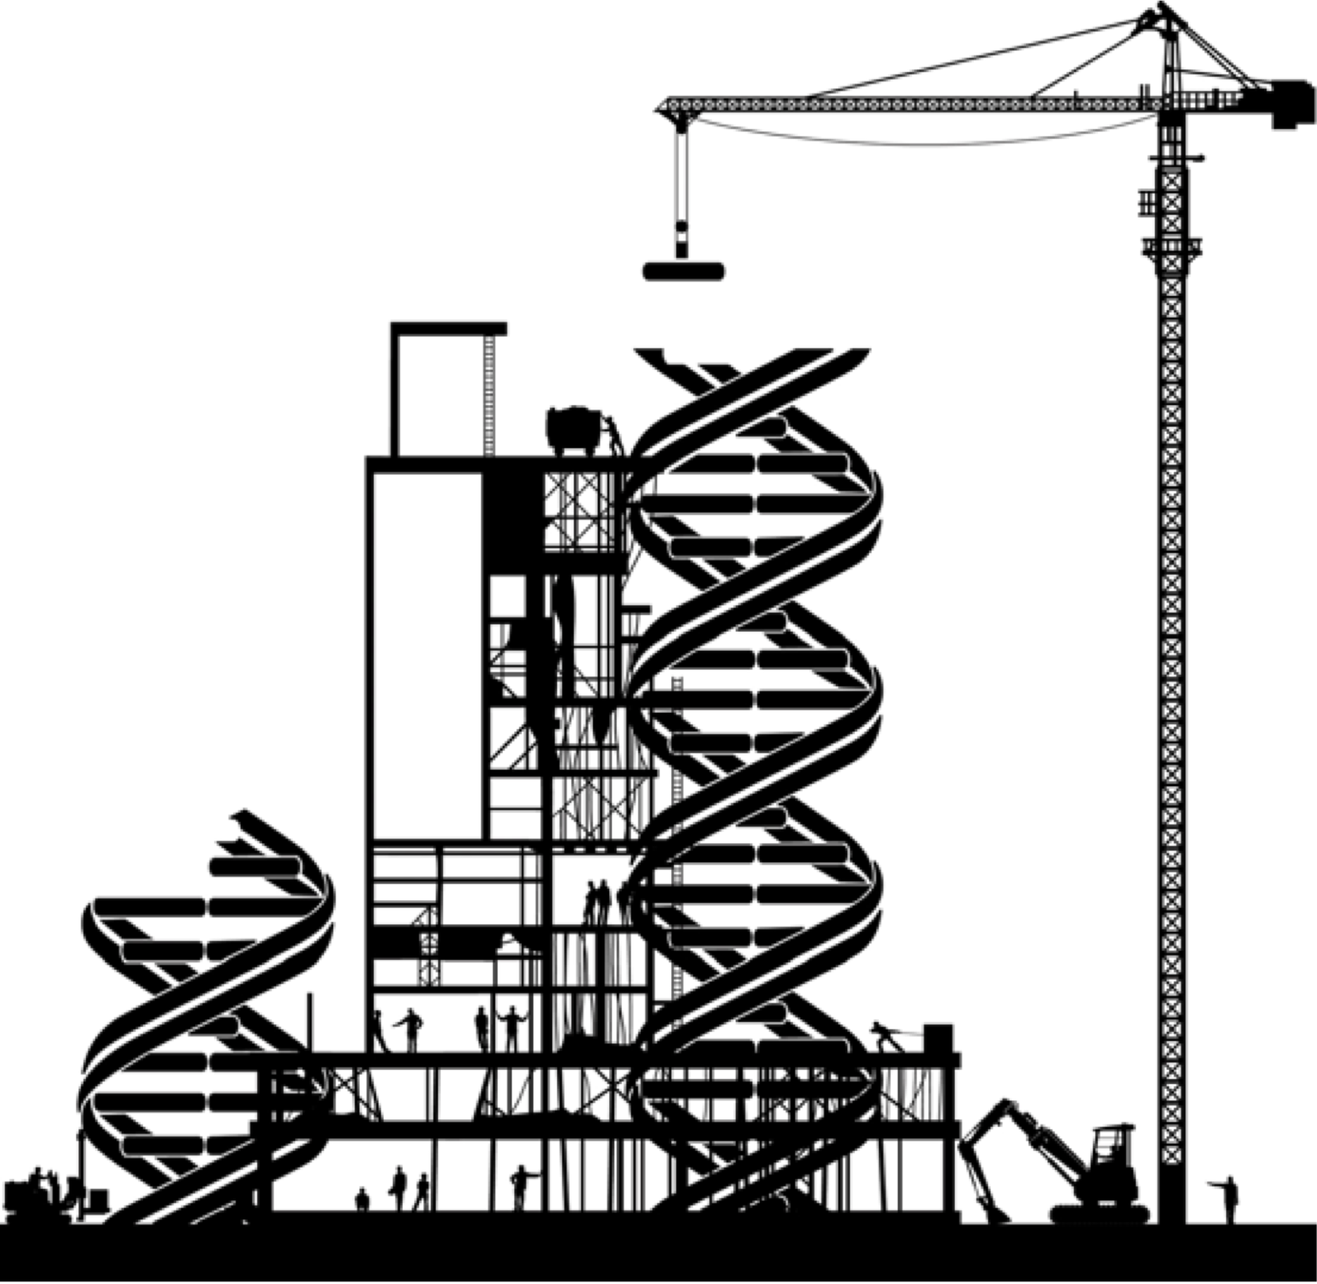
Building the first eukaryotic chromosome
Annaluru, Muller et al. Science 344:55-8. 2014.
2014
The target was chromosome 3, which controls the yeast's sexual reproduction and has 316,617 base pairs of the DNA alphabet: A for adenine, G for guanine, C for cytosine and T for thymine.
Notes:
L'insertion dﾕun chromosome artificiel dans le g始ome dﾕune levure lﾕa confirm� : jamais lﾕhomme nﾕavait atteint une telle capacit� dﾕagir sur le vivant. Et ce nﾕest quﾕun d暫ut. Biologistes, chimistes, anthropologues... r伺l残hissent tous � ces questions vertigineuses. Domaine en pleine ascension, la biologie de synth峻e passionne les scientifiques pour les avanc仔s quﾕelle propose, tant sur la connaissance du vivant que pour ses nombreuses applications industrielles dans les domaines de la sant�, de l'始ergie, des mat屍iaux, de l'environnement et de l'agriculture. Autant dﾕavanc仔s importantes qui soul竣e un grand nombre de questionnements jusquﾕ� la d伺inition m仁e du vivant.

Slide 36

2014
draft genome of the diploid Coffea canephora, one of the two founder species of the tetraploid crop Coffea arabica.
• About 25000 genes
• About 16000 genes derive from a unique gene issued from the flowering plants’ common ancestor.
The coffee genome provides insight into the convergent evolution of caffeine biosynthesis. Denoeud F et al. .Science. 2014 Sep 5;345(6201):1181-4.

Slide 37

2015
1000 Genomes Project
1 October
• Begun in 2008, the project has developed an open resource that now includes the genomic data for more than 2,504 individuals from 26 global populations.
• Analysed using whole-genome sequencing, deep exome sequencing and dense microarray genotyping approaches.
• The data are available via http://www.1000genomes.org/data.

Slide 38
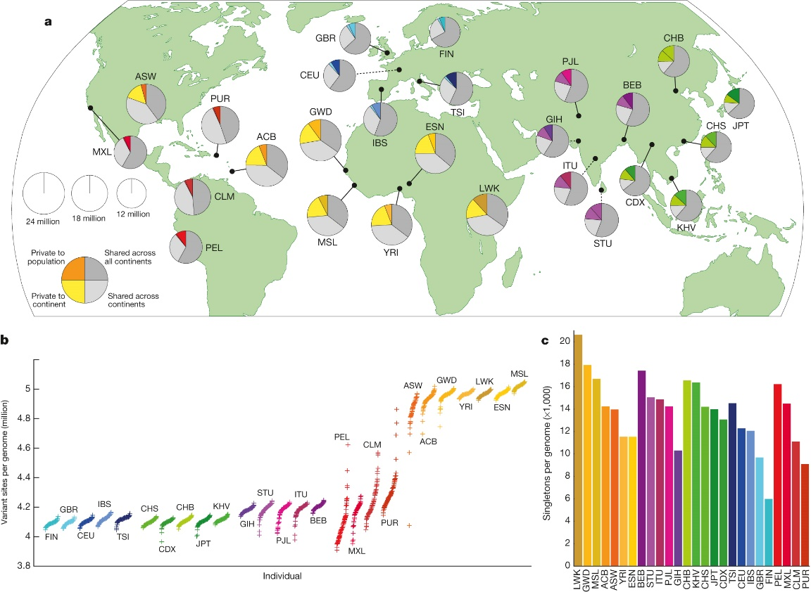
A global reference for human genetic variation
Population sampling
Auton et al. Nature 526, 68-74 (2015) doi:10.1038/nature15393
The 1000 Genomes Project Consortium

Slide 39
They show :
An integrated map of structural variation in the 2504 human genomes
Revealing an impressive:
• 84.7 millions single-nucleotide variants (SNVs)
• 3.6 millions insertion/deletion (indels) variants;
• more than 60000 structural variants (SVs) (ie based on event size >= 15bp )
Sudmant et al. Nature 526, 75-81 (01 October 2015) doi:10.1038/nature15394

Slide 40
Genomic island

Slide 41
Genomic island
Nature Genetics 47, 1221 (2015) doi:10.1038/ng.3436
• Genome of the Netherlands (GoNL) (Nat. Genet. 46, 818-825, 2014)
Whole Genome of 250 Dutch parent-offspring families
• Iceland (http://www.nature.com/ng/focus/icelanders/)
whole genomes of 2,636 Icelanders
• The UK (Nature 526, 82-90, 2015; doi:10.1038/nature14962)
http://www.uk10k.org/
The UK10K project identifies rare variants in health and disease
•The SardiNIA Project (https://sardinia.irp.nia.nih.gov/)
Identify genetic bases for prominent age-associated changes

Slide 42
The SardiNIA Project
https://sardinia.irp.nia.nih.gov/
Finding longevity genes is one of many goals for gerontologists.
An equally important mission is unraveling the genetic processes involved in age-related traits and diseases.
NIA and Italian investigators are focusing their attention on the Mediterranean island of Sardinia:
To identify genetic bases for prominent age-associated changes, including cardiovascular risk factors and determinants of personality traits, in a founder population.
A new genomic Island:
http://www.nature.com/ng/journal/v47/n11/full/ng.3436.html?WT.ec_id=NG-201511&spMailingID=49879982&spUserID=NzEyNjk4MDIyNQS2&spJobID=783928471&spReportId=NzgzOTI4NDcxS0

Slide 43
Small Island, big genetic discoveries
Researchers report results from whole-genome DNA sequencing in 2,120 Sardinians:
they identified ~17.6 million DNA sequence variants, of which 22% are absent from publicly available databases.
This number also includes ~76,000 markers that are common in Sardinia (minor allele frequency (MAF) >5%) but rare elsewhere in the world (MAF <0.5%).
http://www.nature.com/ng/journal/v47/n11/full/ng.3426.html?WT.ec_id=NG-201511&spMailingID=49879982&spUserID=NzEyNjk4MDIyNQS2&spJobID=783928471&spReportId=NzgzOTI4NDcxS0
Notes:
Imputation in genetics refers to the statistical inference of unobserved genotypes.

Slide 44
Height-reducing variants and selection for short stature in Sardinia
Zoledziewska M et al. Nature Genetics 47, 1352-1356 (2015) doi:10.1038/ng.3403
Investigated the genetics of height for Sardinians, one of the shortest populations in Europe.
They identified two variants that are more frequent in Sardinia and have a relatively strong effect on height when compared with the effect of the GWAS (700 variants associated with adult stature) findings (2-4 cm versus <0.3 cm).

Slide 45
National Heart, Lung, and Blood Institute (NHLBI) Exome Sequencing Project (ESP)
Exome Variant Server: http://evs.gs.washington.edu/EVS/
The goal of the NHLBI GO Exome Sequencing Project (ESP) is to discover novel genes and mechanisms contributing to heart, lung and blood disorders by pioneering the application of NGS of the protein coding regions of the human genome across diverse, richly-phenotyped populations and to share these datasets and findings with the scientific community to extend and enrich the diagnosis, management and treatment of heart, lung and blood disorders.

Slide 46
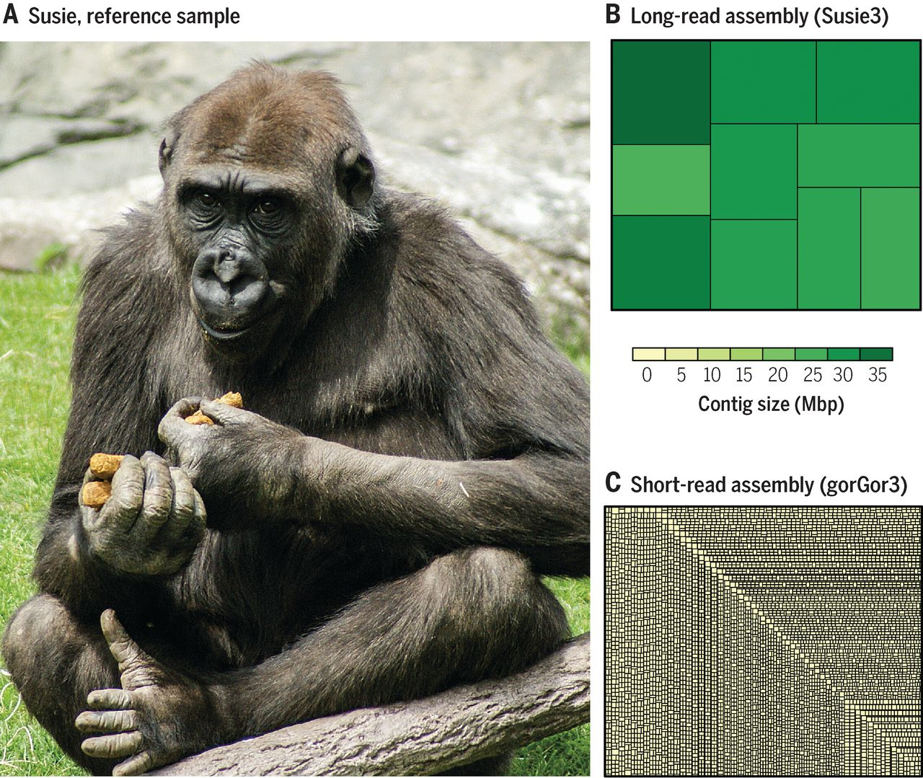
2016
Improving on the gorilla genome
• High-quality assembly of the gorilla genome using single-molecule real-time (SMRT) sequence technology and a string graph de novo assembly algorithm.
• This assembly provides new biological insight into genetic diversity, structural variation, gene loss, and representation of repeat structures within the gorilla genome.
Gordon D, et al. (2016) Long-read sequence assembly of the gorilla genome. Sciences. 352 (6281). 53-57.

Slide 47
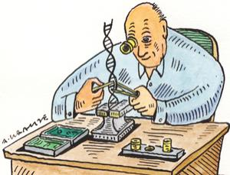
Synthetic Biology

Slide 48
Synthetic Biology
Designing and building genomes
A core theme in synthetic biology, “understanding by creating”, inspired the efforts to generate synthetic cell.
Kannan K and Gibson DG. 2017. Yeast genome, by design. Science, 2017;35pp.1024-1025.

Slide 49
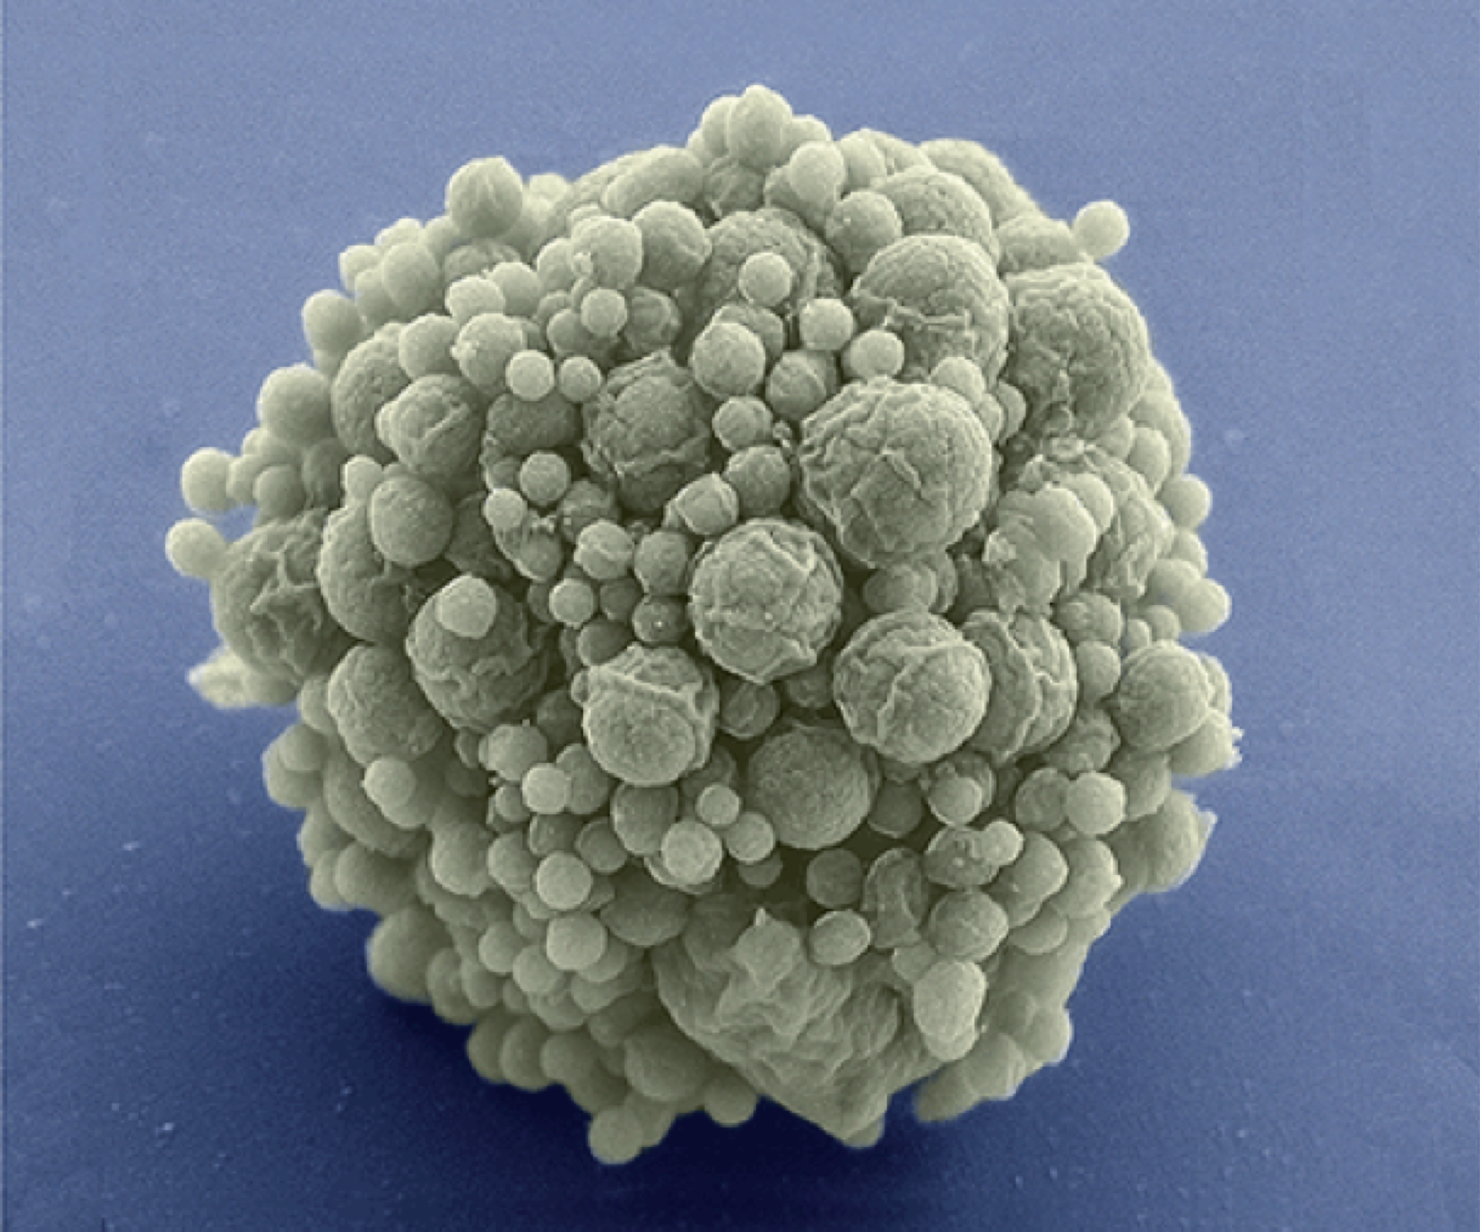
2016
Synthetic Biology
Designing and building a minimal bacterial genome
Three cycles of design, synthesis and testing, with retention of quasi-essential genes, produced JCVI-syn3.0 (531 kilobase pairs, 473 genes), which has a genome smaller than that of any autonomously replicating cell found in nature.
Design and synthesis of a minimal bacterial genome.
Hutchison CA 3rd, et al.Science. 2016 Mar 25;351(6280).

Slide 50
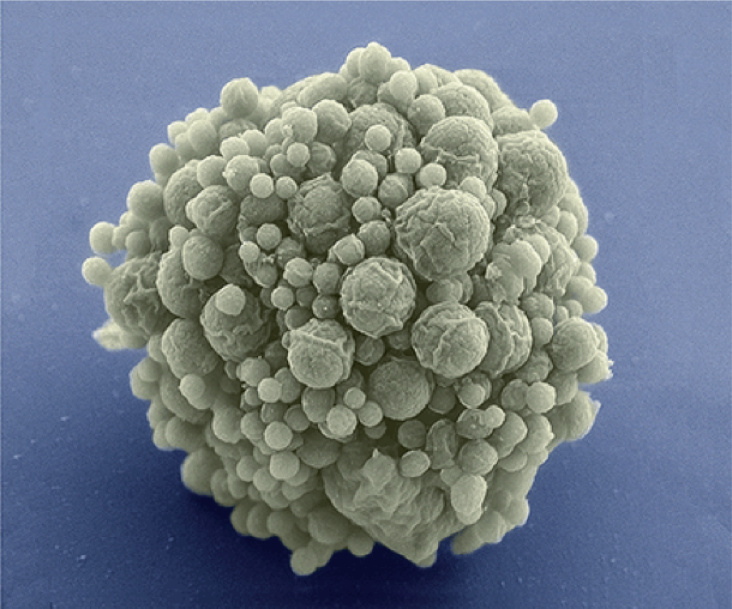
Synthetic microbe has fewest genes, but many mysteries. Robert F. Service
2016
Meet Syn 3.0 and its record-setting small number of genes, 473
Science. 25 Mar 2016:Vol. 351, Issue 6280, pp. 1380-1381DOI: 10.1126/science.351.6280.1380.

Slide 51
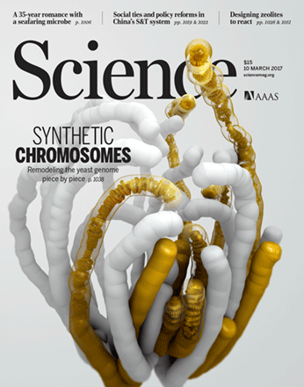
2017
Chemically synthesized genomes like Sc2.0 are fully customizable and allow experimentalists to ask otherwise intractable questions about chromosome structure, function, and evolution with a bottom-up design strategy.
Illustration of a hypothetical yeast genome structure model encompassing all synthetic chromosomes (gold) completed to date (white, native chromosomes). One-third of the chromosomes in the yeast genome have now been designed and synthesized by the Synthetic Yeast Genome Project (Sc2.0). A three-dimensional model of the chromosomes was generated with the Hi-C method. An "envelope" (thick tube shapes) represents the population of chromosome-interacting molecules; translucent tips reveal a 30-nanometer fiber modeled inside.

Slide 52
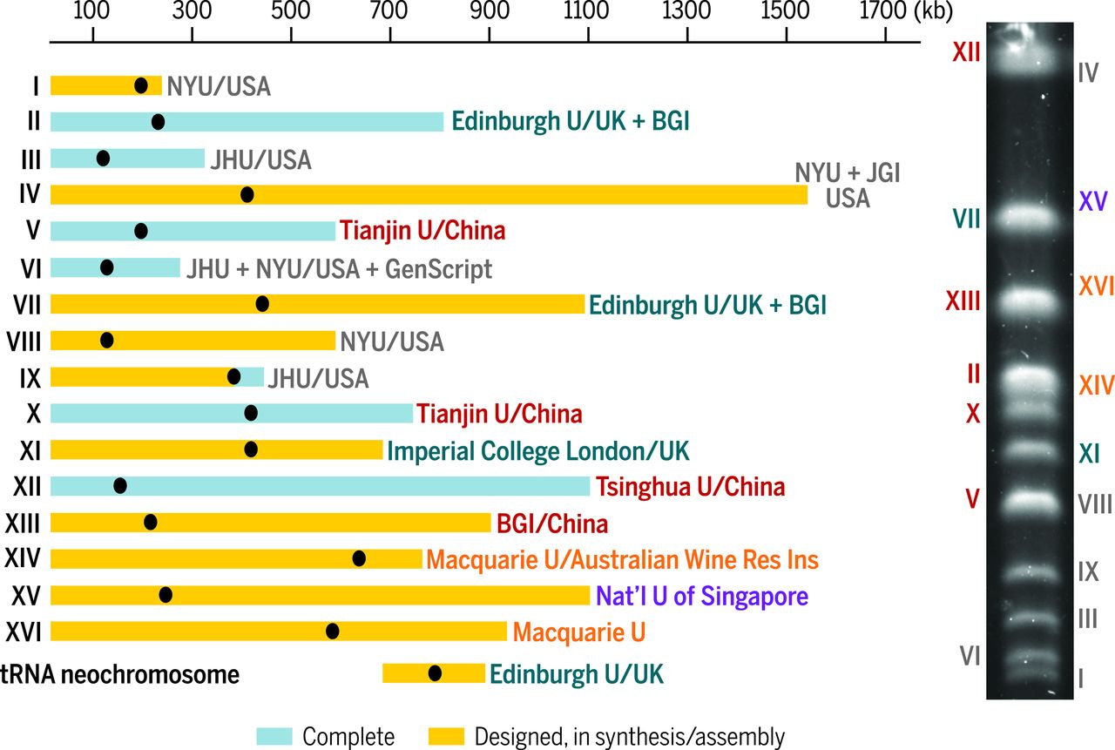

Sc2.0 Consortium chromosome assignments.
When researchers put chunks of synthetic DNA into yeast cells, the cells swapped out parts of their original DNA for the matching engineered snippets.
Sarah M. Richardson et al. Science 2017;355:1040-1044
Design of a synthetic yeast genome
Notes:
Sc2.0 Consortium chromosome assignments. The chromosomes (roman numerals) and their approximate sizes are indicated, along with the lead institution(s) involved in performing chromosome synthesis, assembly, and debugging, as well as raising the needed funds. The gel on the right shows a typical pulsed-field gel of a wild-type strain, with the chromosome-sized DNA molecules identified. Black dots indicate chromosome centromeres. BGI, Beijing Genomics Institute; JGI, Joint Genome Institute of the U.S. Department of Energy; JHU, The Johns Hopkins University; NYU, New York University; U, University; Res Inst, Research Institute.

Slide 53
More genomes and sequencing projects can be followed on:
Genome Announcements
http://genomea.asm.org/
Genome News Network
http://www.genomenewsnetwork.org/

Slide 54
TATTTGATTTTTTGCTTAATTTTTATGTAATTACTTCCCCACAATTTTTGCCCACATATTGTGGATAAAT
ACCTTTAATCTAGAAATTACAATGAATGTTGTTGAAGAAGCACTTGGTGCTGTATTAAAAACTAAGAAGA
TTTCCACATTTTATTCACAATGTTGATAAGTTGTGTAAGTCGACTTGTTGGCTTTATAAAGCAAATGACA
CACTGAAAGTTATCCACAAACAAATTTTTCAAAAGTGTTTAAATCAAAAAGTTATCCACAAATAATGTGG
AAAACTTTTTAATAAATTTGTCGTTTCTTATGCTATCATAGTTTTACATAAATTATTAACTACTATAGGG
AGGCAGTCATGAGTCCAAACAGCACATTATGGCAGACAATATTACAGGATTTAGAAAAACTATACAACGA
GGAGACTTACAACGAGCTATTTCTACCAGTGACTTCTACTTTTAAAGATCAAAACGGATTACTTACAATG
GTTGTAGCTAATGAGTTCTTAAAGAATCGTATCAATAAACTATACATTGCAAAAATTAACGAACTTGCTA
CAAAATATTCAAGTACTCCAGTTAGATTGAAATTCGTATCACAAGAAGAAGTTATTGAAGAACCAGTAGC
TGATCGTAAATTAACCATTGATTATCGTCAAGGGAACTTAAACTCTACCTATACCTTTGACTCTTTTGTT
GTTGGAAAATCTAACATGTTTGCTTTTCGTATGGCGATGAAGGTTGCTGATCAACCTGGAGCAGTAGCAA
ACCCTTTCTACATATTTGGTGATGTAGGTTTAGGTAAAACCCATCTTATGCAAGCAATAGGTAACTATAT
ATTAGATAATGATGTCGAAAAACGTATCTTATATGTTAAAGCTGATAACTTTATTGAAGACTTTGTATCT
TTATTATCAAGAAACAAAAATAAGACTGAAGAATTCAATGCTAAATATAAAGATATTGACGTTATATTAG
TAGACGACATCCAAATTATGGCAAATGCTAGTAAAACTCAAATGGAATTCTTTAAGCTCTTTGACTACCT
ATATTTAAATAATAAACAAATCGTTATAACATCTGATAAACCAGCTTCACAATTAACAAATATCATGCCA
CGTTTAACGACACGTTTTGAAGCTGGTCTCTCTGTAGACATACAAATACCTGAATTAGAACATAGAATAA
GTATTTTAAAGAGAAAAACAGCTACATTAGATGCCAACTTAGAGGTAAGTGAGGATATTTTAACCTTTAT
AGCATCTCAATTTGCAGCAAACATTAGAGAAATGGAAGGTGCACTCATTCGTTTAATTAGTTATGCACAG
ACCTTTAATCTAGAAATTACAATGAATGTTGTTGAAGAAGCACTTGGTGCTGTATTAAAAACTAAGAAGA
AAACAAATGATTTAAACGAAAATAACTACGATAAGATCCAAAGTATTGTAGCAGATTACTTCCAAGTTTC
ATTACCAGACTTAATTGGTAAGAAAAGACATGCTAAATTCACATTACCTAGACATATAGCGATGTATCTT
ATTAAACTTAAATACAATATTCCTTATAAAACAATTGGATCTTTATTTAATGATAGAGACCACTCCACAG
TATTATCTGCTTGTGAAAAAGTAGAACGCGATATGAGGATGGATTCGAACTTAAAGTTTGCTGTTGACTC
GATTGTCAAAAAAATAGATTCACCATTATTAAAGTGATAAATGTTTATAAAAATGATTAAATGTGGTAAA
ATAAATGGTAGATGAAGCGATTATTGCTAGTTTCCCACTTTCCCACAGACACTAACAATAACAAAGAAGA
AATAATAATTAATAAAAGGGGTAAAATATGAATTTTACAATTGAAAGAGATATACGTTCAGTTAACCGGA
How big are genomes?

Slide 55
TATTTGATTTTTTGCTTAATTTTTATGTAATTACTTCCCCACAATTTTTGCCCACATATTGTGGATAAAT
ACCTTTAATCTAGAAATTACAATGAATGTTGTTGAAGAAGCACTTGGTGCTGTATTAAAAACTAAGAAGA
TTTCCACATTTTATTCACAATGTTGATAAGTTGTGTAAGTCGACTTGTTGGCTTTATAAAGCAAATGACA
CACTGAAAGTTATCCACAAACAAATTTTTCAAAAGTGTTTAAATCAAAAAGTTATCCACAAATAATGTGG
AAAACTTTTTAATAAATTTGTCGTTTCTTATGCTATCATAGTTTTACATAAATTATTAACTACTATAGGG
AGGCAGTCATGAGTCCAAACAGCACATTATGGCAGACAATATTACAGGATTTAGAAAAACTATACAACGA
GGAGACTTACAACGAGCTATTTCTACCAGTGACTTCTACTTTTAAAGATCAAAACGGATTACTTACAATG
GTTGTAGCTAATGAGTTCTTAAAGAATCGTATCAATAAACTATACATTGCAAAAATTAACGAACTTGCTA
CAAAATATTCAAGTACTCCAGTTAGATTGAAATTCGTATCACAAGAAGAAGTTATTGAAGAACCAGTAGC
TGATCGTAAATTAACCATTGATTATCGTCAAGGGAACTTAAACTCTACCTATACCTTTGACTCTTTTGTT
GTTGGAAAATCTAACATGTTTGCTTTTCGTATGGCGATGAAGGTTGCTGATCAACCTGGAGCAGTAGCAA
ACCCTTTCTACATATTTGGTGATGTAGGTTTAGGTAAAACCCATCTTATGCAAGCAATAGGTAACTATAT
ATTAGATAATGATGTCGAAAAACGTATCTTATATGTTAAAGCTGATAACTTTATTGAAGACTTTGTATCT
TTATTATCAAGAAACAAAAATAAGACTGAAGAATTCAATGCTAAATATAAAGATATTGACGTTATATTAG
TAGACGACATCCAAATTATGGCAAATGCTAGTAAAACTCAAATGGAATTCTTTAAGCTCTTTGACTACCT
ATATTTAAATAATAAACAAATCGTTATAACATCTGATAAACCAGCTTCACAATTAACAAATATCATGCCA
CGTTTAACGACACGTTTTGAAGCTGGTCTCTCTGTAGACATACAAATACCTGAATTAGAACATAGAATAA
GTATTTTAAAGAGAAAAACAGCTACATTAGATGCCAACTTAGAGGTAAGTGAGGATATTTTAACCTTTAT
AGCATCTCAATTTGCAGCAAACATTAGAGAAATGGAAGGTGCACTCATTCGTTTAATTAGTTATGCACAG
ACCTTTAATCTAGAAATTACAATGAATGTTGTTGAAGAAGCACTTGGTGCTGTATTAAAAACTAAGAAGA
AAACAAATGATTTAAACGAAAATAACTACGATAAGATCCAAAGTATTGTAGCAGATTACTTCCAAGTTTC
ATTACCAGACTTAATTGGTAAGAAAAGACATGCTAAATTCACATTACCTAGACATATAGCGATGTATCTT
ATTAAACTTAAATACAATATTCCTTATAAAACAATTGGATCTTTATTTAATGATAGAGACCACTCCACAG
TATTATCTGCTTGTGAAAAAGTAGAACGCGATATGAGGATGGATTCGAACTTAAAGTTTGCTGTTGACTC
GATTGTCAAAAAAATAGATTCACCATTATTAAAGTGATAAATGTTTATAAAAATGATTAAATGTGGTAAA
ATAAATGGTAGATGAAGCGATTATTGCTAGTTTCCCACTTTCCCACAGACACTAACAATAACAAAGAAGA
AATAATAATTAATAAAAGGGGTAAAATATGAATTTTACAATTGAAAGAGATATACGTTCAGTTAACCGGA
How big are genome sizes?
• Viral genomes: 1 kb to 360 kb (Canarypox virus)
With the discovery of giant viruses:
Pandarovirus: 2.5 Mb
Larger than Encephalitozoon intestinalis (2.3 Mbp)
and similar to Encephalitozoon cuniculi (2.5 Mbp)
• Bacterial genomes: 0.5 Mb to 13 Mb;
• Eukaryotic genomes: 2.3 Mb to 670 Gb (Polychaos dubium ("Amoeba" dubia));

Slide 56
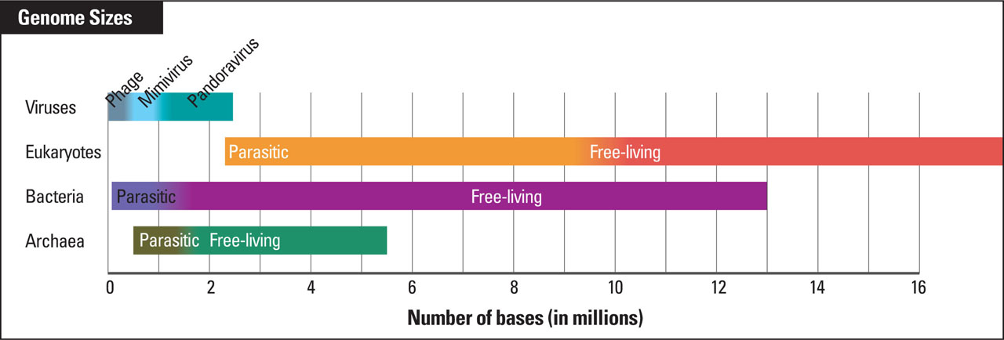
TATTTGATTTTTTGCTTAATTTTTATGTAATTACTTCCCCACAATTTTTGCCCACATATTGTGGATAAAT
ACCTTTAATCTAGAAATTACAATGAATGTTGTTGAAGAAGCACTTGGTGCTGTATTAAAAACTAAGAAGA
TTTCCACATTTTATTCACAATGTTGATAAGTTGTGTAAGTCGACTTGTTGGCTTTATAAAGCAAATGACA
CACTGAAAGTTATCCACAAACAAATTTTTCAAAAGTGTTTAAATCAAAAAGTTATCCACAAATAATGTGG
AAAACTTTTTAATAAATTTGTCGTTTCTTATGCTATCATAGTTTTACATAAATTATTAACTACTATAGGG
AGGCAGTCATGAGTCCAAACAGCACATTATGGCAGACAATATTACAGGATTTAGAAAAACTATACAACGA
GGAGACTTACAACGAGCTATTTCTACCAGTGACTTCTACTTTTAAAGATCAAAACGGATTACTTACAATG
GTTGTAGCTAATGAGTTCTTAAAGAATCGTATCAATAAACTATACATTGCAAAAATTAACGAACTTGCTA
CAAAATATTCAAGTACTCCAGTTAGATTGAAATTCGTATCACAAGAAGAAGTTATTGAAGAACCAGTAGC
TGATCGTAAATTAACCATTGATTATCGTCAAGGGAACTTAAACTCTACCTATACCTTTGACTCTTTTGTT
GTTGGAAAATCTAACATGTTTGCTTTTCGTATGGCGATGAAGGTTGCTGATCAACCTGGAGCAGTAGCAA
ACCCTTTCTACATATTTGGTGATGTAGGTTTAGGTAAAACCCATCTTATGCAAGCAATAGGTAACTATAT
ATTAGATAATGATGTCGAAAAACGTATCTTATATGTTAAAGCTGATAACTTTATTGAAGACTTTGTATCT
TTATTATCAAGAAACAAAAATAAGACTGAAGAATTCAATGCTAAATATAAAGATATTGACGTTATATTAG
TAGACGACATCCAAATTATGGCAAATGCTAGTAAAACTCAAATGGAATTCTTTAAGCTCTTTGACTACCT
ATATTTAAATAATAAACAAATCGTTATAACATCTGATAAACCAGCTTCACAATTAACAAATATCATGCCA
CGTTTAACGACACGTTTTGAAGCTGGTCTCTCTGTAGACATACAAATACCTGAATTAGAACATAGAATAA
GTATTTTAAAGAGAAAAACAGCTACATTAGATGCCAACTTAGAGGTAAGTGAGGATATTTTAACCTTTAT
AGCATCTCAATTTGCAGCAAACATTAGAGAAATGGAAGGTGCACTCATTCGTTTAATTAGTTATGCACAG
ACCTTTAATCTAGAAATTACAATGAATGTTGTTGAAGAAGCACTTGGTGCTGTATTAAAAACTAAGAAGA
AAACAAATGATTTAAACGAAAATAACTACGATAAGATCCAAAGTATTGTAGCAGATTACTTCCAAGTTTC
ATTACCAGACTTAATTGGTAAGAAAAGACATGCTAAATTCACATTACCTAGACATATAGCGATGTATCTT
ATTAAACTTAAATACAATATTCCTTATAAAACAATTGGATCTTTATTTAATGATAGAGACCACTCCACAG
TATTATCTGCTTGTGAAAAAGTAGAACGCGATATGAGGATGGATTCGAACTTAAAGTTTGCTGTTGACTC
GATTGTCAAAAAAATAGATTCACCATTATTAAAGTGATAAATGTTTATAAAAATGATTAAATGTGGTAAA
ATAAATGGTAGATGAAGCGATTATTGCTAGTTTCCCACTTTCCCACAGACACTAACAATAACAAAGAAGA
AATAATAATTAATAAAAGGGGTAAAATATGAATTTTACAATTGAAAGAGATATACGTTCAGTTAACCGGA
2.5 Mb
1 kb - 360kb
2.3 Mb
670 Gb
0.5 Mb
13 Mb
Pennisi E. (2013). Science. 341:226-7.
Notes:
• Viral genomes: 1 kb to 360 kb (Canarypox virus)
With the discovery of giant viruses:
Pandarovirus: 2.5 Mb
Larger than Encephalitozoon intestinalis (2.3 Mbp)
and similar to Encephalitozoon cuniculi (2.5 Mbp)
• Bacterial genomes: 0.5 Mb to 13 Mb;
• Eukaryotic genomes: 2.3 Mb to 670 Gb (Polychaos dubium ("Amoeba" dubia));

Slide 57
Genome sizes (in base pairs)
TATTTGATTTTTTGCTTAATTTTTATGTAATTACTTCCCCACAATTTTTGCCCACATATTGTGGATAAAT
ACCTTTAATCTAGAAATTACAATGAATGTTGTTGAAGAAGCACTTGGTGCTGTATTAAAAACTAAGAAGA
TTTCCACATTTTATTCACAATGTTGATAAGTTGTGTAAGTCGACTTGTTGGCTTTATAAAGCAAATGACA
CACTGAAAGTTATCCACAAACAAATTTTTCAAAAGTGTTTAAATCAAAAAGTTATCCACAAATAATGTGG
AAAACTTTTTAATAAATTTGTCGTTTCTTATGCTATCATAGTTTTACATAAATTATTAACTACTATAGGG
AGGCAGTCATGAGTCCAAACAGCACATTATGGCAGACAATATTACAGGATTTAGAAAAACTATACAACGA
GGAGACTTACAACGAGCTATTTCTACCAGTGACTTCTACTTTTAAAGATCAAAACGGATTACTTACAATG
GTTGTAGCTAATGAGTTCTTAAAGAATCGTATCAATAAACTATACATTGCAAAAATTAACGAACTTGCTA
CAAAATATTCAAGTACTCCAGTTAGATTGAAATTCGTATCACAAGAAGAAGTTATTGAAGAACCAGTAGC
TGATCGTAAATTAACCATTGATTATCGTCAAGGGAACTTAAACTCTACCTATACCTTTGACTCTTTTGTT
GTTGGAAAATCTAACATGTTTGCTTTTCGTATGGCGATGAAGGTTGCTGATCAACCTGGAGCAGTAGCAA
ACCCTTTCTACATATTTGGTGATGTAGGTTTAGGTAAAACCCATCTTATGCAAGCAATAGGTAACTATAT
ATTAGATAATGATGTCGAAAAACGTATCTTATATGTTAAAGCTGATAACTTTATTGAAGACTTTGTATCT
TTATTATCAAGAAACAAAAATAAGACTGAAGAATTCAATGCTAAATATAAAGATATTGACGTTATATTAG
TAGACGACATCCAAATTATGGCAAATGCTAGTAAAACTCAAATGGAATTCTTTAAGCTCTTTGACTACCT
ATATTTAAATAATAAACAAATCGTTATAACATCTGATAAACCAGCTTCACAATTAACAAATATCATGCCA
CGTTTAACGACACGTTTTGAAGCTGGTCTCTCTGTAGACATACAAATACCTGAATTAGAACATAGAATAA
GTATTTTAAAGAGAAAAACAGCTACATTAGATGCCAACTTAGAGGTAAGTGAGGATATTTTAACCTTTAT
AGCATCTCAATTTGCAGCAAACATTAGAGAAATGGAAGGTGCACTCATTCGTTTAATTAGTTATGCACAG
ACCTTTAATCTAGAAATTACAATGAATGTTGTTGAAGAAGCACTTGGTGCTGTATTAAAAACTAAGAAGA
AAACAAATGATTTAAACGAAAATAACTACGATAAGATCCAAAGTATTGTAGCAGATTACTTCCAAGTTTC
ATTACCAGACTTAATTGGTAAGAAAAGACATGCTAAATTCACATTACCTAGACATATAGCGATGTATCTT
ATTAAACTTAAATACAATATTCCTTATAAAACAATTGGATCTTTATTTAATGATAGAGACCACTCCACAG
TATTATCTGCTTGTGAAAAAGTAGAACGCGATATGAGGATGGATTCGAACTTAAAGTTTGCTGTTGACTC
GATTGTCAAAAAAATAGATTCACCATTATTAAAGTGATAAATGTTTATAAAAATGATTAAATGTGGTAAA
ATAAATGGTAGATGAAGCGATTATTGCTAGTTTCCCACTTTCCCACAGACACTAACAATAACAAAGAAGA
AATAATAATTAATAAAAGGGGTAAAATATGAATTTTACAATTGAAAGAGATATACGTTCAGTTAACCGGA
plasmids
viruses
bacteria
fungi
plants
algae
insects
mollusks
bony fish
amphibians
reptiles
The size of the human
genome is ~ 3 X 10⁹ bp.
birds
mammals
10⁴
10⁵
10⁶
10⁷
10⁸
10⁹
10¹⁰
10¹¹
http://www3.kumc.edu/jcalvet/PowerPoint/bioc801b.ppt

Slide 58
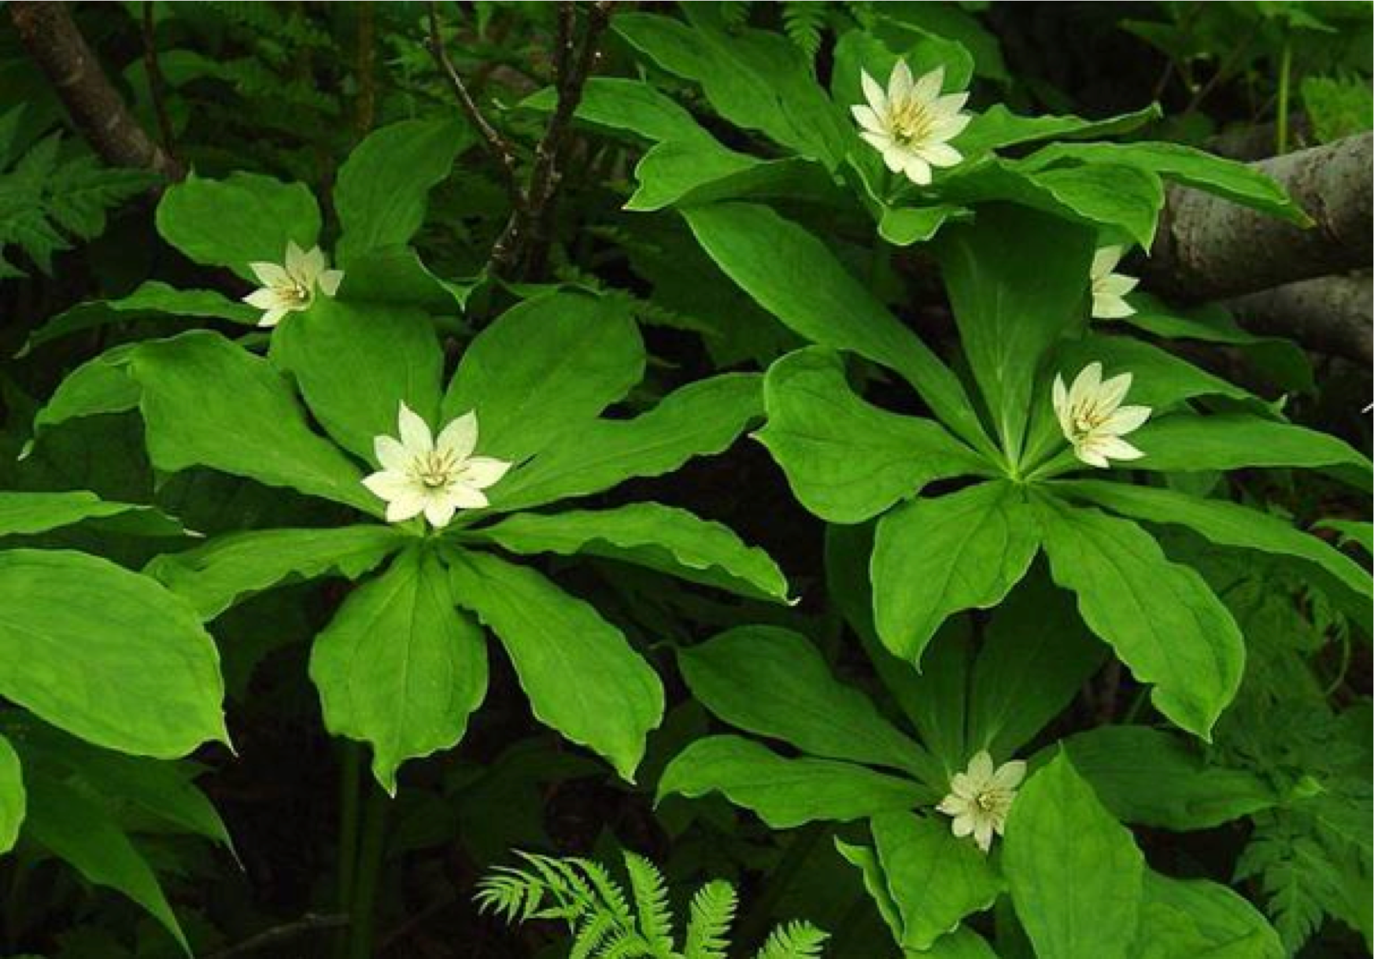
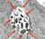
Largest Plant Genome
TATTTGATTTTTTGCTTAATTTTTATGTAATTACTTCCCCACAATTTTTGCCCACATATTGTGGATAAAT
ACCTTTAATCTAGAAATTACAATGAATGTTGTTGAAGAAGCACTTGGTGCTGTATTAAAAACTAAGAAGA
TTTCCACATTTTATTCACAATGTTGATAAGTTGTGTAAGTCGACTTGTTGGCTTTATAAAGCAAATGACA
CACTGAAAGTTATCCACAAACAAATTTTTCAAAAGTGTTTAAATCAAAAAGTTATCCACAAATAATGTGG
AAAACTTTTTAATAAATTTGTCGTTTCTTATGCTATCATAGTTTTACATAAATTATTAACTACTATAGGG
AGGCAGTCATGAGTCCAAACAGCACATTATGGCAGACAATATTACAGGATTTAGAAAAACTATACAACGA
GGAGACTTACAACGAGCTATTTCTACCAGTGACTTCTACTTTTAAAGATCAAAACGGATTACTTACAATG
GTTGTAGCTAATGAGTTCTTAAAGAATCGTATCAATAAACTATACATTGCAAAAATTAACGAACTTGCTA
CAAAATATTCAAGTACTCCAGTTAGATTGAAATTCGTATCACAAGAAGAAGTTATTGAAGAACCAGTAGC
TGATCGTAAATTAACCATTGATTATCGTCAAGGGAACTTAAACTCTACCTATACCTTTGACTCTTTTGTT
GTTGGAAAATCTAACATGTTTGCTTTTCGTATGGCGATGAAGGTTGCTGATCAACCTGGAGCAGTAGCAA
ACCCTTTCTACATATTTGGTGATGTAGGTTTAGGTAAAACCCATCTTATGCAAGCAATAGGTAACTATAT
ATTAGATAATGATGTCGAAAAACGTATCTTATATGTTAAAGCTGATAACTTTATTGAAGACTTTGTATCT
TTATTATCAAGAAACAAAAATAAGACTGAAGAATTCAATGCTAAATATAAAGATATTGACGTTATATTAG
TAGACGACATCCAAATTATGGCAAATGCTAGTAAAACTCAAATGGAATTCTTTAAGCTCTTTGACTACCT
ATATTTAAATAATAAACAAATCGTTATAACATCTGATAAACCAGCTTCACAATTAACAAATATCATGCCA
CGTTTAACGACACGTTTTGAAGCTGGTCTCTCTGTAGACATACAAATACCTGAATTAGAACATAGAATAA
GTATTTTAAAGAGAAAAACAGCTACATTAGATGCCAACTTAGAGGTAAGTGAGGATATTTTAACCTTTAT
AGCATCTCAATTTGCAGCAAACATTAGAGAAATGGAAGGTGCACTCATTCGTTTAATTAGTTATGCACAG
ACCTTTAATCTAGAAATTACAATGAATGTTGTTGAAGAAGCACTTGGTGCTGTATTAAAAACTAAGAAGA
AAACAAATGATTTAAACGAAAATAACTACGATAAGATCCAAAGTATTGTAGCAGATTACTTCCAAGTTTC
ATTACCAGACTTAATTGGTAAGAAAAGACATGCTAAATTCACATTACCTAGACATATAGCGATGTATCTT
ATTAAACTTAAATACAATATTCCTTATAAAACAATTGGATCTTTATTTAATGATAGAGACCACTCCACAG
TATTATCTGCTTGTGAAAAAGTAGAACGCGATATGAGGATGGATTCGAACTTAAAGTTTGCTGTTGACTC
GATTGTCAAAAAAATAGATTCACCATTATTAAAGTGATAAATGTTTATAAAAATGATTAAATGTGGTAAA
ATAAATGGTAGATGAAGCGATTATTGCTAGTTTCCCACTTTCCCACAGACACTAACAATAACAAAGAAGA
AATAATAATTAATAAAAGGGGTAAAATATGAATTTTACAATTGAAAGAGATATACGTTCAGTTAACCGGA
Paris Japonica (150,000 Mb) (largest Plant genome)
PELLICER, J., FAY, M. F. and LEITCH, I. J. (2010), The largest eukaryotic genome of them all?
Botanical Journal of the Linnean Society, 164: 10-15.
Smallest Eukaryotic Genome:
Encephalitozoon intestinalis (2.3 Mbp)

Slide 59
The smallest reported Bacterial Genomes:
Tremblaya princeps (139 kb) - 198 genes
a symbiont of Planococcus citrimealybugs (PCIT). Tremblaya PCIT possesses its own bacterial endosymbiont, Moranella endobia.
Husnik F. et al. 2013. Cell.153:1567-78.
Candidatus Nasuia deltocephalinicola
Size= 0.112091 #proteins: 137 #Genes 169 GC%=17.1
Small, smaller, smallest: the origins and evolution of ancient dual symbioses in a Phloem-feeding insect. Bennett GM, et al. Genome Biol Evol 2013

Slide 60
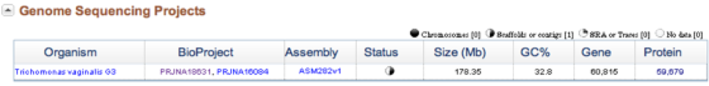
TATTTGATTTTTTGCTTAATTTTTATGTAATTACTTCCCCACAATTTTTGCCCACATATTGTGGATAAAT
ACCTTTAATCTAGAAATTACAATGAATGTTGTTGAAGAAGCACTTGGTGCTGTATTAAAAACTAAGAAGA
TTTCCACATTTTATTCACAATGTTGATAAGTTGTGTAAGTCGACTTGTTGGCTTTATAAAGCAAATGACA
CACTGAAAGTTATCCACAAACAAATTTTTCAAAAGTGTTTAAATCAAAAAGTTATCCACAAATAATGTGG
AAAACTTTTTAATAAATTTGTCGTTTCTTATGCTATCATAGTTTTACATAAATTATTAACTACTATAGGG
AGGCAGTCATGAGTCCAAACAGCACATTATGGCAGACAATATTACAGGATTTAGAAAAACTATACAACGA
GGAGACTTACAACGAGCTATTTCTACCAGTGACTTCTACTTTTAAAGATCAAAACGGATTACTTACAATG
GTTGTAGCTAATGAGTTCTTAAAGAATCGTATCAATAAACTATACATTGCAAAAATTAACGAACTTGCTA
CAAAATATTCAAGTACTCCAGTTAGATTGAAATTCGTATCACAAGAAGAAGTTATTGAAGAACCAGTAGC
TGATCGTAAATTAACCATTGATTATCGTCAAGGGAACTTAAACTCTACCTATACCTTTGACTCTTTTGTT
GTTGGAAAATCTAACATGTTTGCTTTTCGTATGGCGATGAAGGTTGCTGATCAACCTGGAGCAGTAGCAA
ACCCTTTCTACATATTTGGTGATGTAGGTTTAGGTAAAACCCATCTTATGCAAGCAATAGGTAACTATAT
ATTAGATAATGATGTCGAAAAACGTATCTTATATGTTAAAGCTGATAACTTTATTGAAGACTTTGTATCT
TTATTATCAAGAAACAAAAATAAGACTGAAGAATTCAATGCTAAATATAAAGATATTGACGTTATATTAG
TAGACGACATCCAAATTATGGCAAATGCTAGTAAAACTCAAATGGAATTCTTTAAGCTCTTTGACTACCT
ATATTTAAATAATAAACAAATCGTTATAACATCTGATAAACCAGCTTCACAATTAACAAATATCATGCCA
CGTTTAACGACACGTTTTGAAGCTGGTCTCTCTGTAGACATACAAATACCTGAATTAGAACATAGAATAA
GTATTTTAAAGAGAAAAACAGCTACATTAGATGCCAACTTAGAGGTAAGTGAGGATATTTTAACCTTTAT
AGCATCTCAATTTGCAGCAAACATTAGAGAAATGGAAGGTGCACTCATTCGTTTAATTAGTTATGCACAG
ACCTTTAATCTAGAAATTACAATGAATGTTGTTGAAGAAGCACTTGGTGCTGTATTAAAAACTAAGAAGA
AAACAAATGATTTAAACGAAAATAACTACGATAAGATCCAAAGTATTGTAGCAGATTACTTCCAAGTTTC
ATTACCAGACTTAATTGGTAAGAAAAGACATGCTAAATTCACATTACCTAGACATATAGCGATGTATCTT
ATTAAACTTAAATACAATATTCCTTATAAAACAATTGGATCTTTATTTAATGATAGAGACCACTCCACAG
TATTATCTGCTTGTGAAAAAGTAGAACGCGATATGAGGATGGATTCGAACTTAAAGTTTGCTGTTGACTC
GATTGTCAAAAAAATAGATTCACCATTATTAAAGTGATAAATGTTTATAAAAATGATTAAATGTGGTAAA
ATAAATGGTAGATGAAGCGATTATTGCTAGTTTCCCACTTTCCCACAGACACTAACAATAACAAAGAAGA
AATAATAATTAATAAAAGGGGTAAAATATGAATTTTACAATTGAAAGAGATATACGTTCAGTTAACCGGA
Actually, the highest known number of genes is around 60,815, for the protozoan parasite Trichomonas vaginalis causing trichomoniasis
Carlton JM, et al. Science 2007
Draft genome sequence of the sexually transmitted pathogen Trichomonas vaginalis.

Slide 61
Size(Mb) distribution of bacterial species
Path=1
Tekaia F. 2017. Unpublished results.

Slide 62
Size distribution of archaeal species
Path = 1
Tekaia F. 2017. Unpublished results.

Slide 63
Size(Mb) distribution of eukaryotic species
Tekaia F. 2017. Unpublished results.

Slide 64
TATTTGATTTTTTGCTTAATTTTTATGTAATTACTTCCCCACAATTTTTGCCCACATATTGTGGATAAAT
ACCTTTAATCTAGAAATTACAATGAATGTTGTTGAAGAAGCACTTGGTGCTGTATTAAAAACTAAGAAGA
TTTCCACATTTTATTCACAATGTTGATAAGTTGTGTAAGTCGACTTGTTGGCTTTATAAAGCAAATGACA
CACTGAAAGTTATCCACAAACAAATTTTTCAAAAGTGTTTAAATCAAAAAGTTATCCACAAATAATGTGG
AAAACTTTTTAATAAATTTGTCGTTTCTTATGCTATCATAGTTTTACATAAATTATTAACTACTATAGGG
AGGCAGTCATGAGTCCAAACAGCACATTATGGCAGACAATATTACAGGATTTAGAAAAACTATACAACGA
GGAGACTTACAACGAGCTATTTCTACCAGTGACTTCTACTTTTAAAGATCAAAACGGATTACTTACAATG
GTTGTAGCTAATGAGTTCTTAAAGAATCGTATCAATAAACTATACATTGCAAAAATTAACGAACTTGCTA
CAAAATATTCAAGTACTCCAGTTAGATTGAAATTCGTATCACAAGAAGAAGTTATTGAAGAACCAGTAGC
TGATCGTAAATTAACCATTGATTATCGTCAAGGGAACTTAAACTCTACCTATACCTTTGACTCTTTTGTT
GTTGGAAAATCTAACATGTTTGCTTTTCGTATGGCGATGAAGGTTGCTGATCAACCTGGAGCAGTAGCAA
ACCCTTTCTACATATTTGGTGATGTAGGTTTAGGTAAAACCCATCTTATGCAAGCAATAGGTAACTATAT
ATTAGATAATGATGTCGAAAAACGTATCTTATATGTTAAAGCTGATAACTTTATTGAAGACTTTGTATCT
TTATTATCAAGAAACAAAAATAAGACTGAAGAATTCAATGCTAAATATAAAGATATTGACGTTATATTAG
TAGACGACATCCAAATTATGGCAAATGCTAGTAAAACTCAAATGGAATTCTTTAAGCTCTTTGACTACCT
ATATTTAAATAATAAACAAATCGTTATAACATCTGATAAACCAGCTTCACAATTAACAAATATCATGCCA
CGTTTAACGACACGTTTTGAAGCTGGTCTCTCTGTAGACATACAAATACCTGAATTAGAACATAGAATAA
GTATTTTAAAGAGAAAAACAGCTACATTAGATGCCAACTTAGAGGTAAGTGAGGATATTTTAACCTTTAT
AGCATCTCAATTTGCAGCAAACATTAGAGAAATGGAAGGTGCACTCATTCGTTTAATTAGTTATGCACAG
ACCTTTAATCTAGAAATTACAATGAATGTTGTTGAAGAAGCACTTGGTGCTGTATTAAAAACTAAGAAGA
AAACAAATGATTTAAACGAAAATAACTACGATAAGATCCAAAGTATTGTAGCAGATTACTTCCAAGTTTC
ATTACCAGACTTAATTGGTAAGAAAAGACATGCTAAATTCACATTACCTAGACATATAGCGATGTATCTT
ATTAAACTTAAATACAATATTCCTTATAAAACAATTGGATCTTTATTTAATGATAGAGACCACTCCACAG
TATTATCTGCTTGTGAAAAAGTAGAACGCGATATGAGGATGGATTCGAACTTAAAGTTTGCTGTTGACTC
GATTGTCAAAAAAATAGATTCACCATTATTAAAGTGATAAATGTTTATAAAAATGATTAAATGTGGTAAA
ATAAATGGTAGATGAAGCGATTATTGCTAGTTTCCCACTTTCCCACAGACACTAACAATAACAAAGAAGA
AATAATAATTAATAAAAGGGGTAAAATATGAATTTTACAATTGAAAGAGATATACGTTCAGTTAACCGGA
Some K Genomes Projects

Slide 65
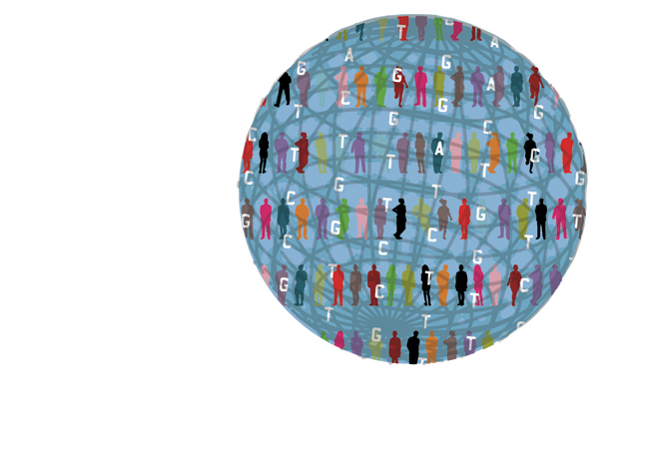
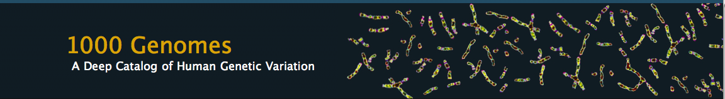
Human 1000 genomes project: 2008 - 2015
TATTTGATTTTTTGCTTAATTTTTATGTAATTACTTCCCCACAATTTTTGCCCACATATTGTGGATAAAT
ACCTTTAATCTAGAAATTACAATGAATGTTGTTGAAGAAGCACTTGGTGCTGTATTAAAAACTAAGAAGA
TTTCCACATTTTATTCACAATGTTGATAAGTTGTGTAAGTCGACTTGTTGGCTTTATAAAGCAAATGACA
CACTGAAAGTTATCCACAAACAAATTTTTCAAAAGTGTTTAAATCAAAAAGTTATCCACAAATAATGTGG
AAAACTTTTTAATAAATTTGTCGTTTCTTATGCTATCATAGTTTTACATAAATTATTAACTACTATAGGG
AGGCAGTCATGAGTCCAAACAGCACATTATGGCAGACAATATTACAGGATTTAGAAAAACTATACAACGA
GGAGACTTACAACGAGCTATTTCTACCAGTGACTTCTACTTTTAAAGATCAAAACGGATTACTTACAATG
GTTGTAGCTAATGAGTTCTTAAAGAATCGTATCAATAAACTATACATTGCAAAAATTAACGAACTTGCTA
CAAAATATTCAAGTACTCCAGTTAGATTGAAATTCGTATCACAAGAAGAAGTTATTGAAGAACCAGTAGC
TGATCGTAAATTAACCATTGATTATCGTCAAGGGAACTTAAACTCTACCTATACCTTTGACTCTTTTGTT
GTTGGAAAATCTAACATGTTTGCTTTTCGTATGGCGATGAAGGTTGCTGATCAACCTGGAGCAGTAGCAA
ACCCTTTCTACATATTTGGTGATGTAGGTTTAGGTAAAACCCATCTTATGCAAGCAATAGGTAACTATAT
ATTAGATAATGATGTCGAAAAACGTATCTTATATGTTAAAGCTGATAACTTTATTGAAGACTTTGTATCT
TTATTATCAAGAAACAAAAATAAGACTGAAGAATTCAATGCTAAATATAAAGATATTGACGTTATATTAG
TAGACGACATCCAAATTATGGCAAATGCTAGTAAAACTCAAATGGAATTCTTTAAGCTCTTTGACTACCT
ATATTTAAATAATAAACAAATCGTTATAACATCTGATAAACCAGCTTCACAATTAACAAATATCATGCCA
CGTTTAACGACACGTTTTGAAGCTGGTCTCTCTGTAGACATACAAATACCTGAATTAGAACATAGAATAA
GTATTTTAAAGAGAAAAACAGCTACATTAGATGCCAACTTAGAGGTAAGTGAGGATATTTTAACCTTTAT
AGCATCTCAATTTGCAGCAAACATTAGAGAAATGGAAGGTGCACTCATTCGTTTAATTAGTTATGCACAG
ACCTTTAATCTAGAAATTACAATGAATGTTGTTGAAGAAGCACTTGGTGCTGTATTAAAAACTAAGAAGA
AAACAAATGATTTAAACGAAAATAACTACGATAAGATCCAAAGTATTGTAGCAGATTACTTCCAAGTTTC
ATTACCAGACTTAATTGGTAAGAAAAGACATGCTAAATTCACATTACCTAGACATATAGCGATGTATCTT
ATTAAACTTAAATACAATATTCCTTATAAAACAATTGGATCTTTATTTAATGATAGAGACCACTCCACAG
TATTATCTGCTTGTGAAAAAGTAGAACGCGATATGAGGATGGATTCGAACTTAAAGTTTGCTGTTGACTC
GATTGTCAAAAAAATAGATTCACCATTATTAAAGTGATAAATGTTTATAAAAATGATTAAATGTGGTAAA
ATAAATGGTAGATGAAGCGATTATTGCTAGTTTCCCACTTTCCCACAGACACTAACAATAACAAAGAAGA
AATAATAATTAATAAAAGGGGTAAAATATGAATTTTACAATTGAAAGAGATATACGTTCAGTTAACCGGA
http://www.1000genomes.org/
See also: http://www.internationalgenome.org/about
is an international collaboration to produce an extensive public catalog of human genetic variation, including SNPs, structural variants and their haplotype contexts.
This resource will aid our understanding of the role of genetic variation in human history, evolution and disease.
See tutorials about the project: http://genome.gov/27542240

Slide 66
IGSR: The International Genome Sample Resource
is providing ongoing support for the 1000 Genomes Project data
26 populations
http://www.internationalgenome.org/about
Notes:
IGSR is providing ongoing support for the 1000 Genomes Project data

Slide 67
Human 1000 genomes project
See recent published papers (free access) in: http://www.nature.com/nature/focus/1000genomes/index.html
Nature 491, 56-65 (01 November 2012)
An integrated map of genetic variation from 1,092 human genomes from 14 populations:
-> Validated haplotype map of 38 millions SNPs;
-> 1.4 millions short insertions and deletions;
-> 14000 larger deletions.
Using ancient DNA and 1000 genomes project data:
The genomic landscape of Neanderthal ancestry in present-day humans.
Sriram Sankararaman et al. Nature 507, 354-357 (20 March 2014)

Slide 68
Human 1000 genomes project
A global reference for human genetic variation
Nature 526, 68-74 (01 October 2015) doi:10.1038/nature15393
• The 1000 Genomes Project set out to provide a comprehensive description of common human genetic variation by applying whole-genome sequencing to a diverse set of individuals from multiple populations.
• At the completion of the project, the genomes of 2,504 individuals from 26 populations was reconstructed using a combination of low-coverage whole-genome sequencing, deep exome sequencing, and dense microarray genotyping.
• A broad spectrum of genetic variation was characterized, in total over 88 million variants (84.7 million single nucleotide polymorphisms (SNPs), 3.6 million short insertions/deletions (indels), and 60,000 structural variants), all phased onto high-quality haplotypes. This resource includes >99% of SNP variants with a frequency of >1% for a variety of ancestries.
• the work included a description of the distribution of genetic variation across the global sample, and discuss the implications for common disease studies.

Slide 69
The UK10K project identifies rare variants in health and disease
http://www.nature.com/nature/journal/v526/n7571/full/nature14962.html
http://www.uk10k.org/
In total, 3,781 individuals were successfully whole-genome sequenced in the UK10K-cohorts.
After conservative quality control filtering, the final call set contained:
- over 42M single nucleotide variants (SNVs, 34.2M rare and 2.2M low-frequency),
- ~3.5M insertion/deletion polymorphisms (INDELs; 2,291,553 rare and 415,735 low-frequency) and
- 18,739 large deletions (median size 3.7 kilobase).

Slide 70
Human Microbiome Project (HMP)
http://commonfund.nih.gov/hmp/
-> about 2,267 kg microbes in human body;
-> Microbes in a healthy human adult are estimated to outnumber human cells by a ratio of : 10 to 1;
-> The total number of genes in the microbiome exceeds the number of genes in the human genome by a factor of more than 200.
https://www.bcm.edu/departments/molecular-virology-and-microbiology/research/the-human-microbiome-project
Notes:
The Human MicrobiomeThe human microbiome is defined as the collection of microbes -ﾊbacteria,ﾊviruses, and single-cell eukaryotesﾊ- that inhabits the human body. Microbes in a healthy human adult are estimated to outnumber human cells by a ratio of ten to one, and the total number ofﾊgenesﾊin the microbiome exceeds the number of genes in the humanﾊgenomeﾊby a factor of at least 200. Even though microbial cells are only one-tenth to one-hundredth the size of a human cell, they may account for up to five pounds of adult body weight.Although bacteria are often associated with infections, the bacteria that colonize the surface and insides of our bodies are essential for life. We are dependent on these bacteria to help digest our food, produce certain vitamins, regulate our immune system, and keep us healthy by protecting us against disease-causing bacteria.The composition of the entire collection of microbes that make up the microbiome and its influence on our health and susceptibility to disease is not easily investigated. To date, only a small percentage of the bacteria that comprise the human microbiome have been identified, and a limited number of individual microorganisms have been studied. It simply has not been possible to isolate the vast majority (>95%) of microorganisms and culture them, presumably because the required growth conditions have not or cannot be reproduced in the laboratory. However, recent technological advances inﾊDNAﾊsequencing and the development of a method known as metagenomics have now made it feasible to analyze the entire human microbiome.

Slide 71
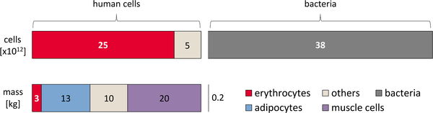

Fig 3. Distribution of cell number and mass for different cell types in the human body (for a 70 kg adult man).
Sender R, Fuchs S, Milo R (2016) Revised Estimates for the Number of Human and Bacteria Cells in the Body. PLoS Biol 14(8): e1002533. doi:10.1371/journal.pbio.1002533
http://journals.plos.org/plosbiology/article?id=info:doi/10.1371/journal.pbio.1002533

Slide 72
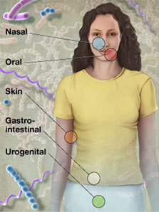
Human Microbiome Project (HMP)
TATTTGATTTTTTGCTTAATTTTTATGTAATTACTTCCCCACAATTTTTGCCCACATATTGTGGATAAAT
ACCTTTAATCTAGAAATTACAATGAATGTTGTTGAAGAAGCACTTGGTGCTGTATTAAAAACTAAGAAGA
TTTCCACATTTTATTCACAATGTTGATAAGTTGTGTAAGTCGACTTGTTGGCTTTATAAAGCAAATGACA
CACTGAAAGTTATCCACAAACAAATTTTTCAAAAGTGTTTAAATCAAAAAGTTATCCACAAATAATGTGG
AAAACTTTTTAATAAATTTGTCGTTTCTTATGCTATCATAGTTTTACATAAATTATTAACTACTATAGGG
AGGCAGTCATGAGTCCAAACAGCACATTATGGCAGACAATATTACAGGATTTAGAAAAACTATACAACGA
GGAGACTTACAACGAGCTATTTCTACCAGTGACTTCTACTTTTAAAGATCAAAACGGATTACTTACAATG
GTTGTAGCTAATGAGTTCTTAAAGAATCGTATCAATAAACTATACATTGCAAAAATTAACGAACTTGCTA
CAAAATATTCAAGTACTCCAGTTAGATTGAAATTCGTATCACAAGAAGAAGTTATTGAAGAACCAGTAGC
TGATCGTAAATTAACCATTGATTATCGTCAAGGGAACTTAAACTCTACCTATACCTTTGACTCTTTTGTT
GTTGGAAAATCTAACATGTTTGCTTTTCGTATGGCGATGAAGGTTGCTGATCAACCTGGAGCAGTAGCAA
ACCCTTTCTACATATTTGGTGATGTAGGTTTAGGTAAAACCCATCTTATGCAAGCAATAGGTAACTATAT
ATTAGATAATGATGTCGAAAAACGTATCTTATATGTTAAAGCTGATAACTTTATTGAAGACTTTGTATCT
TTATTATCAAGAAACAAAAATAAGACTGAAGAATTCAATGCTAAATATAAAGATATTGACGTTATATTAG
TAGACGACATCCAAATTATGGCAAATGCTAGTAAAACTCAAATGGAATTCTTTAAGCTCTTTGACTACCT
ATATTTAAATAATAAACAAATCGTTATAACATCTGATAAACCAGCTTCACAATTAACAAATATCATGCCA
CGTTTAACGACACGTTTTGAAGCTGGTCTCTCTGTAGACATACAAATACCTGAATTAGAACATAGAATAA
GTATTTTAAAGAGAAAAACAGCTACATTAGATGCCAACTTAGAGGTAAGTGAGGATATTTTAACCTTTAT
AGCATCTCAATTTGCAGCAAACATTAGAGAAATGGAAGGTGCACTCATTCGTTTAATTAGTTATGCACAG
ACCTTTAATCTAGAAATTACAATGAATGTTGTTGAAGAAGCACTTGGTGCTGTATTAAAAACTAAGAAGA
AAACAAATGATTTAAACGAAAATAACTACGATAAGATCCAAAGTATTGTAGCAGATTACTTCCAAGTTTC
ATTACCAGACTTAATTGGTAAGAAAAGACATGCTAAATTCACATTACCTAGACATATAGCGATGTATCTT
ATTAAACTTAAATACAATATTCCTTATAAAACAATTGGATCTTTATTTAATGATAGAGACCACTCCACAG
TATTATCTGCTTGTGAAAAAGTAGAACGCGATATGAGGATGGATTCGAACTTAAAGTTTGCTGTTGACTC
GATTGTCAAAAAAATAGATTCACCATTATTAAAGTGATAAATGTTTATAAAAATGATTAAATGTGGTAAA
ATAAATGGTAGATGAAGCGATTATTGCTAGTTTCCCACTTTCCCACAGACACTAACAATAACAAAGAAGA
AATAATAATTAATAAAAGGGGTAAAATATGAATTTTACAATTGAAAGAGATATACGTTCAGTTAACCGGA
http://commonfund.nih.gov/hmp/
Aims to characterize microbial communities found in human body including: nasal passages, oral cavities, skin, gastrointestinal tract, and uro-genital tract and to analyse the role of these microbes in human health and disease.

Slide 73

Compositional Differences In Microbiome By Anatomical Sites
The human microbiome: at the interface of health and disease.
Cho I, Blaser MJ.Nat Rev Genet. 2012; 13(4):260-70.
Notes:
High-throughput sequencing has revealed substantial intra-individual microbiome variation at different anatomical sites, and inter-individual variation at the same anatomical sites4, 5, 25, 52, 89, 93. However, higher-level (for example, at the level of phyla) taxonomic features display temporal (longitudinal) stability in individuals at specific anatomical sites. Such site-specific differences and the observed conservation between human hosts provide an important framework to determine the biological and pathological significance of a particular microbiome composition. The figure indicates the relative proportion of sequences determined at the taxonomic phylum level at eight anatomical sites. Certain features, such as the presence (+) or absence (ﾐ) of Helicobacter pylori, can lead to permanent and marked perturbations in community composition93.

Slide 74


Abundant taxa in the human microbiome that have been
metagenomically and taxonomically well defined in the HMP population.
C Huttenhower et al. Nature 486, 207-214 (2012) doi:10.1038/nature11234
Structure, function and diversity of the healthy human microbiome
Notes:
aﾐc, Prevalence (intensity, colour denoting phylum/class) and abundance when present (size) of clades in the healthy microbiome. The most abundant metagenomically-identified species (a), 16S-identified genera (b) and PATRIC12 pathogens (metagenomic) (c) are shown. d, e, The population size and sequencing depths of the HMP have well defined the microbiome at all assayed body sites, as assessed by saturation of added community metabolic configurations (rarefaction of minimum BrayﾐCurtis beta-diversity of metagenomic enzyme class abundances to nearest neighbour, inter-quartile range over 100 samples) (d) and phylogenetic configurations (minimum 16S OTU weighted UniFrac distance to nearest neighbour) (e).

Slide 75
Microbiome studies have already allowed significant advances in many diseases
Recent studies showed well-established links between the diversity of for example a healthy gut microbiome and protection against diseases.
Nussinov R, Papin JA (2017) How can computation advance microbiome research? PLoS Comput Biol13(9): e1005547.

Slide 76
Microbiome studies have already allowed significant advances in many diseases
• Possible link was observed between gut bacteria of mice and Parkinson disease. Changes in the bacteria populating in the gut apparently appear to be associated with a decline in motor skills.
Sampson TR, et al. (2016). Gut Microbiota Regulate Motor Deficits and Neuroinflammation in a Model of Parkinson’s Disease. Cell, 167 (6) 1469–1480.
• An earlier study suggested that Parkinson disease may start in the stomach, because people who had their vagus nerve cut to treat gastric ulcers exhibited a lower risk of Parkinson disease than those whose treatment involved only a partial dissection.
Svensson E, et al. (2015). Vagotomy and subsequent risk of Parkinson's disease. Annals of Neurology, 78 (4) 522–529
Notes:
Possible link that was observed between gut bacteria of mice and Parkinson disease, in which changes in the bacteria populating the gut apparently appear to be associated with a decline in motor skills. How can this be? It turns out that 70% of all neurons in the peripheral nervous system are located in the gut, and these are directly connected to the central nervous system through the vagus nerve.

Slide 77
Microbiome studies have already allowed significant advances in many diseases
• It was found that gut bacteria may have a role in autism and there is evidence that a single species of gut bacteria can reverse autism-related social behaviour in mice.
Buffington SA, et al. (2016). Microbial Reconstitution Reverses Maternal Diet-Induced Social and Synaptic Deficits in Offspring. Cell, 165 (7) 1762–75.
• There is emerging evidence for relationships between disruptions in the human microbiome and (among many other diseases):
- cancer,
Vogtmann E, Goedert JJ, (2016) Epidemiologic studies of the human microbiome and cancer. British Journal of Cancer, 114 (3) 237–42.
- cardiovascular disease,
Wang Z, et al. (2011). Gut flora metabolism of phosphatidylcholine promotes cardiovascular disease. Nature 472 (7341) 57–63 pmid:21475195.

Slide 78
Microbiome studies have already allowed significant advances in many diseases
…....continued
- obesity,
Cox LM, et al. (2014) Altering the Intestinal Microbiota during a Critical Developmental Window Has Lasting Metabolic Consequences. Cell 158 (4) 725–721.
- food allergies,
Stefka AT, et al. (2014) Commensal bacteria protect against food allergen sensitization. PNAS 111 (36) 13145–13150 pmid:25157157.
-Asthma
Huang YJ, Boushey HA, (2015) The microbiome in asthma. The Journal of Allergy and Clinical Immunonlogy 135 (1) 25–30.
• The microbiota also has important roles in cancer therapy.
Roy S, Trinchieri G, (2017) Microbiota: a key orchestrator of cancer therapy. Nature Reviews Cancer 17, 271–285.
• Tumour growth can be suppressed by biofilm-producing bacteria.
Ericsson AC, et al. (2015) Differential susceptibility to colorectal cancer due to naturally occurring gut microbiota. 6 (32) 33689–33704.

Slide 79


International Cancer Genome Consortium (https://icgc.org/)
Cancer Genome Project (89 project teams) 50 tumor types
TATTTGATTTTTTGCTTAATTTTTATGTAATTACTTCCCCACAATTTTTGCCCACATATTGTGGATAAAT
ACCTTTAATCTAGAAATTACAATGAATGTTGTTGAAGAAGCACTTGGTGCTGTATTAAAAACTAAGAAGA
TTTCCACATTTTATTCACAATGTTGATAAGTTGTGTAAGTCGACTTGTTGGCTTTATAAAGCAAATGACA
CACTGAAAGTTATCCACAAACAAATTTTTCAAAAGTGTTTAAATCAAAAAGTTATCCACAAATAATGTGG
AAAACTTTTTAATAAATTTGTCGTTTCTTATGCTATCATAGTTTTACATAAATTATTAACTACTATAGGG
AGGCAGTCATGAGTCCAAACAGCACATTATGGCAGACAATATTACAGGATTTAGAAAAACTATACAACGA
GGAGACTTACAACGAGCTATTTCTACCAGTGACTTCTACTTTTAAAGATCAAAACGGATTACTTACAATG
GTTGTAGCTAATGAGTTCTTAAAGAATCGTATCAATAAACTATACATTGCAAAAATTAACGAACTTGCTA
CAAAATATTCAAGTACTCCAGTTAGATTGAAATTCGTATCACAAGAAGAAGTTATTGAAGAACCAGTAGC
TGATCGTAAATTAACCATTGATTATCGTCAAGGGAACTTAAACTCTACCTATACCTTTGACTCTTTTGTT
GTTGGAAAATCTAACATGTTTGCTTTTCGTATGGCGATGAAGGTTGCTGATCAACCTGGAGCAGTAGCAA
ACCCTTTCTACATATTTGGTGATGTAGGTTTAGGTAAAACCCATCTTATGCAAGCAATAGGTAACTATAT
ATTAGATAATGATGTCGAAAAACGTATCTTATATGTTAAAGCTGATAACTTTATTGAAGACTTTGTATCT
TTATTATCAAGAAACAAAAATAAGACTGAAGAATTCAATGCTAAATATAAAGATATTGACGTTATATTAG
TAGACGACATCCAAATTATGGCAAATGCTAGTAAAACTCAAATGGAATTCTTTAAGCTCTTTGACTACCT
ATATTTAAATAATAAACAAATCGTTATAACATCTGATAAACCAGCTTCACAATTAACAAATATCATGCCA
CGTTTAACGACACGTTTTGAAGCTGGTCTCTCTGTAGACATACAAATACCTGAATTAGAACATAGAATAA
GTATTTTAAAGAGAAAAACAGCTACATTAGATGCCAACTTAGAGGTAAGTGAGGATATTTTAACCTTTAT
AGCATCTCAATTTGCAGCAAACATTAGAGAAATGGAAGGTGCACTCATTCGTTTAATTAGTTATGCACAG
ACCTTTAATCTAGAAATTACAATGAATGTTGTTGAAGAAGCACTTGGTGCTGTATTAAAAACTAAGAAGA
AAACAAATGATTTAAACGAAAATAACTACGATAAGATCCAAAGTATTGTAGCAGATTACTTCCAAGTTTC
ATTACCAGACTTAATTGGTAAGAAAAGACATGCTAAATTCACATTACCTAGACATATAGCGATGTATCTT
ATTAAACTTAAATACAATATTCCTTATAAAACAATTGGATCTTTATTTAATGATAGAGACCACTCCACAG
TATTATCTGCTTGTGAAAAAGTAGAACGCGATATGAGGATGGATTCGAACTTAAAGTTTGCTGTTGACTC
GATTGTCAAAAAAATAGATTCACCATTATTAAAGTGATAAATGTTTATAAAAATGATTAAATGTGGTAAA
ATAAATGGTAGATGAAGCGATTATTGCTAGTTTCCCACTTTCCCACAGACACTAACAATAACAAAGAAGA
AATAATAATTAATAAAAGGGGTAAAATATGAATTTTACAATTGAAAGAGATATACGTTCAGTTAACCGGA

Slide 80
International Cancer Genome Consortium (icgc.org)
• The International Cancer Genome Consortium (ICGC) has been organized to launch and coordinate a large number of research projects that have the common aim of elucidating comprehensively the genomic changes present in many forms of cancers.
• ICGC goal is: to obtain a comprehensive description of genomic, transcriptomic and epigenomic changes in 50 different tumor types and/or subtypes which are of clinical and societal importance across the globe.

Slide 81

DNAdigest and Repositive: Connecting the World of Genomic Data
Kovalevskaya NV, et al. DNAdigest and Repositive: Connecting the World of Genomic Data.PLoS Biol. 2016 Mar 24;14(3):e1002418.

Slide 82

List of Repositories for Genomic Data

Slide 83

List of downloadable Genomic Data

Slide 84

1001 genomes project:
Arabidopsis thaliana Genetic Variation
http://1001genomes.org/

Slide 85
https://www.wheatgenome.org

Slide 86

2014
The 3000 rice genomes project
GigaScience Database: http://gigadb.org/dataset/200001
A core collection of 3,000 rice accessions from 89 countries.
Approximately 18.9 million SNPs in rice were discovered when aligned to the reference genome of the temperate japonica variety, Nipponbare.

Slide 87

Phylogenetic analyses based on SNP data confirmed differentiation of the O. sativa gene pool into 5 varietal groups - indica, aus/boro, basmati/sadri, tropical japonica and temperate japonica.

Slide 88

http://1000.fungalgenomes.org/home/
1KFG
Sequencing unsampled fungal diversity
There are more than 800 genomes in the JGI Mycocosm resource:
https://genome.jgi.doe.gov/fungi/fungi.info.html

Slide 89



http://1000bullgenomes.com
The selected animals include a large number of Holstein bulls, Jerseys, Fleckvieh and Angus. Future runs will also include members of Brown Swiss, Ayrshire, and Simmental.

Slide 90

http://www.earthmicrobiome.org/
Meeting Report: The Terabase Metagenomics Workshop and the Vision of an Earth Microbiome Project. Stand. Genomic Sci. 2010 3:3
Notes:
The Earth Microbiome Project is a proposed massively multidisciplinary effort to analyze microbial communities across the globe. The general premise is to examine microbial communities from their own perspective. Hence we propose to characterize the Earth by environmental parameter space into different biomes and then explore these using samples currently available from researchers across the globe. We will analyze 200,000 samples from these communities using metagenomics, metatranscriptomics and amplicon sequencing to produce a global Gene Atlas describing protein space, environmental metabolic models for each biome, approximately 500,000 reconstructed microbial genomes, a global metabolic model, and a data-analysis portal for visualization of all information.

Slide 91

Earth microbiome project
(http://www.microbio.me/emp/)

Slide 92
Earth microbiome project
(http://www.microbio.me/emp/)
A communal catalogue reveals Earth’s multiscale microbial diversity.
Thompson LR et al. Consortium
Nature (2017) doi:10.1038/nature24621
http://www.nature.com/nature/journal/vaop/ncurrent/full/nature24621.html?WT.ec_id=NATURE-20171102&spMailingID=55269410&spUserID=NzEyNjk4MDIyMwS2&spJobID=1280170708&spReportId=MTI4MDE3MDcwOAS2

Slide 93

BGI's Young Chinese Scientists Will Map Any Genome
http://www.businessweek.com/articles/2013-02-07/bgis-young-chinese-scientists-will-map-any-genome#p1

Slide 94


10,000 Microbial Genomes Project (BGI)
http://ldl.genomics.cn/page/M-research.jsp
1000 Mendelian Disorders Project (BGI)
http://ldl.genomics.cn/page/D-research.jsp
Notes:
BGI, officially launched 10,000 Microbial Genomes Projects on 1st August, 2009, calls for collaborations all over the world. The project aims to generate over 10,000 microbial references genomes in 2 years, covering the fields of industry, factory, bioenergy, environment and medicine. For more details, please see the web site of http://ldl.genomics.cn. More than 1000 microbial genomes sequenced in BGI are showed in the right pie graph and many other projects are ongoing.
Mendelian disorder refers to a disease caused by single-gene mutation. The mutation can either occur on a single chromosome or a pair of homologous chromosomes. At present, about 5000 Mendelian disorders have been found in human. Generally, there are five modes of inheritance for Mendelian disorders. For the past several decades, genes underlying Mendelian disorders have been identified through positional cloning, physical mapping and candidate-gene sequencing. Compared with the traditional linkage analysis, which depend on the big and good pedigree selection, next-generation sequencing is more advanced with the ability to discover novel causative genes for Mendelian disorders, by choosing a small pedigree and a few samples of patients for sequencing and analysis (Table 1). There have been thirteen papers and more published in top magazines since last year. It illustrated that next-generation sequencing is an extremely efficient and cost-effective approach for identification of a rare variant compared with many proposed methods.

Slide 95

1,000 Plant and Animal Reference Genomes Project (BGI)
http://ldl.genomics.org.cn/page/pa-research.jsp
Notes:
In January 2010, BGI launched the 1,000 Plant & Animal reference genomes project and called for collaboration from around the world. The goal of the project is to generate reference genomes for 1,000 economically and scientifically important plant/animal species. Together with our collaborators, so far we have initiated 505 plant and animal genome projects, completed genome maps for over 100 species and finished the sequencing of about 200 species. The completed projects include rice, silkworm, cucumber, panda, camel, oyster, ant, grouper, goose, crested ibis, potato genomes, and more. Many other genomes are in process of active sequencing. We look for more collaboration to complete the tree of reference genomes.

Slide 96

https://genome10k.soe.ucsc.edu/
A proposal to obtain whole genome sequence for 10 000 vertebrate species.
find and sequence at least one individual from each of the approximately 66,000 vertebrate species.

Slide 97
i5k Insect and other Arthropod Genome Sequencing Initiative
http://www.arthropodgenomes.org/wiki/i5K

Slide 98
http://www.sciencemag.org/news/2017/02/biologists-propose-sequence-dna-all-life-earth

Slide 99
http://www.sciencemag.org/news/2017/07/plant-scientists-plan-massive-effort-sequence-10000-genomes

Slide 100

http://www.giantvirus.org/top.html

Slide 101

Giant viruses found in Austrian sewage fuel debate over potential fourth domain of life
By Mitch LeslieApr. 6, 2017 , 2:00 PM

Slide 102
Metagenomics
Metagenome: The DNA obtained from uncultured micro-organisms (microbial communities). Exp. in the sea, earth, human body,…
Metagenomics: The study of genomic DNA obtained from uncultured micro-organisms
• Focus on metagenomics:
http://www.nature.com/nrmicro/focus/metagenomics/index.html
• Primer on metagenomics:
http://www.ploscompbiol.org/article/info%3Adoi%2F10.1371%2Fjournal.pcbi.1000667
• The New Science of Metagenomics Revealing the Secrets of Our Microbial Planet. National Research Council (US) Committee on Metagenomics: Challenges and Functional Applications.
http://www.ncbi.nlm.nih.gov/books/NBK54006/
Notes:
Metagenomics is a discipline that enables the genomic study of uncultured microorganisms. Faster, cheaper sequencing technologies and the ability to sequence uncultured microbes sampled directly from their habitats are expanding and transforming our view of the microbial world. Distilling meaningful information from the millions of new genomic sequences presents a serious challenge to bioinformaticians. In cultured microbes, the genomic data come from a single clone, making sequence assembly and annotation tractable. In metagenomics, the data come from heterogeneous microbial communities, sometimes containing more than 10,000 species, with the sequence data being noisy and partial. From sampling, to assembly, to gene calling and function prediction, bioinformatics faces new demands in interpreting voluminous, noisy, and often partial sequence data.

Slide 103


Environmental Shotgun Sequencing (ESS).
Wooley JC, Godzik A, Friedberg I (2010) A Primer on Metagenomics. PLoS Comput Biol 6(2): e1000667. doi:10.1371/journal.pcbi.1000667
http://www.ploscompbiol.org/article/info:doi/10.1371/journal.pcbi.1000667

Slide 104
Next-generation sequencing technologies
allowed a massive increase in available raw sequence data
Implying a number of new informatics, computational challenges and difficulties.
• New class of bioinformatics methods and tools
Curr Opin Biotechnol. 2012 Feb;23(1):9-15. doi: 10.1016/j.copbio.2011.11.013. Epub 2011 Dec 9.Next generation sequencing and bioinformatic bottlenecks: the current state of metagenomic data analysis.Scholz MB, Lo CC, Chain PS.

Slide 105
Next-generation sequencing technologies
• Next-Generation Sequencing (NGS) has evolved into a popular strategy for genotyping.
• The advantage of the NGS approach also include higher coverage and resolution, more accurate estimation of copy numbers, more precise detection of breakpoints, and higher capabilities to identify novel CNVs.
• High coverage, read pairs, long reads

Slide 106

http://www.oxfordjournals.org/our_journals/bioinformatics/nextgenerationsequencing.html
Algorithms - Tools
for NGS

Slide 107
A variety of applications
• Genomes: de novo or re-sequencing;
• Transcriptome sequencing (RNA-Seq);
• Cancer genomics;
• Human genetic variation analyses:
-Single Nucleotide Polymorphism (SNP), - Small Insertion/Deletion (Indels), Structural variations (SV);
• Disease-targeted sequencing;
• Epidemiology;
• Clinical applications (therapeutic decisions);
…..
Papers on Application of Next-Generation Sequencing:
http://www.nature.com/nrg/series/nextgeneration/index.html

Slide 108

Mappers for High-Throughput Sequencing Data
http://wwwdev.ebi.ac.uk/fg/hts_mappers/
"Tools for mapping high-throughput sequencing data", Bioinformatics (2012) 28 (24): 3169-3177.

Slide 109


Basic workflow for whole-exome and whole-genome sequencing projects
Pabinger S. et al. 2013. A survey of tools for variant analysis of next-generation genome sequencing data.

Slide 110

Integrative Genomics Viewer: File formats
http://www.broadinstitute.org/igv/fileformats
Particularly those used by NGS data analysis tools

Slide 111
Sequencing costs

Slide 112

http://www.genome.gov/sequencingcosts/
Notes:
The cost-accounting data presented here are summarized relative to two metrics: (1) "Cost per Megabase of DNA Sequence" - the cost of determining one megabase (Mb; a million bases) of DNA sequence of a specified quality
To illustrate the nature of the reductions in DNA sequencing costs, each graph also shows hypothetical data reflecting Moore's Law, which describes a long-term trend in the computer hardware industry that involves the doubling of 'compute power' every two years (See: Moore's Law [wikipedia.org]). Technology improvements that 'keep up' with Moore's Law are widely regarded to be doing exceedingly well, making it useful for comparison.
In both graphs, note: (1) the use a logarithmic scale on the Y axis; and (2) the sudden and profound out-pacing of Moore's Law beginning in January 2008. The latter represents the time when the sequencing centers transitioned from Sanger-based (dideoxy chain termination sequencing) to 'second generation' (or 'next-generation') DNA sequencing technologies. Additional details about these graphs are provided below.

Slide 113

http://www.genome.gov/sequencingcosts/
"Moore's Law", states that the number of transistors on a chip will double about every two years.
Human genome:
First draft in 2001, final 2004. Estimated costs $3 billions. Time 13 years/Now few days.
NGS caused costs to drop faster than would be expected by Moore’s law.
A personal genome dropped to $1245 in 2017 from $340,000 in 2008.
A full Bacterial/Archaeaon genome costs < US$100.
https://www.scienceexchange.com/services/whole-genome-seq

Slide 114

Pocket-sized sequencers start to pay off big
In Antarctica, the MinION proved capable of sequencing well even under harsh conditions
Elizabeth Pennisi. 2017. Science 356 (6338), 572-573.

Slide 115
Where can we find Genome data?
Genomes Resources
Nucleic Acids Research Table of Contents Alert Database issue Vol. 45, No. D1, 4 January 2017
http://nar.oxfordjournals.org/content/45/D1?etoc

Slide 116
Resources for genomes
There are two main archive resources for genomes:
ncbi National Center for Biotechnology Information
http://www.ncbi.nlm.nih.gov/sites/genome
ebi European Bioinformatics Institute
http://www.ebi.ac.uk/genomes/
Many others resources are available from sequencing Institutions including:
Sanger The welcome Trust Sanger Institut
http://www.sanger.ac.uk/resources/downloads/
Ensembl http://www.ensembl.org/index.html
Broad Institut http://www.broadinstitute.org/science/data
Genomes News Network http://www.genomenewsnetwork.org/
…and many other sites for specific projects

Slide 117

ncbi National Center for Biotechnology Information
http://www.ncbi.nlm.nih.gov/genome/browse/
17/03/2017

Slide 118

Eukaryotes: http://www.ncbi.nlm.nih.gov/genome/browse

Slide 119

Eukaryotes: http://www.ncbi.nlm.nih.gov/genome/browse

Slide 120

Bacteria
http://www.ncbi.nlm.nih.gov/genome/browse/

Slide 121

Archaea
http://www.ncbi.nlm.nih.gov/genome/browse/

Slide 122

Viral genomes (Virus):
http://www.ncbi.nlm.nih.gov/genome/browse

Slide 123

Microbial Genomes (Bacteria):
http://www.ncbi.nlm.nih.gov/genomes/lproks.cgi
whole fasta sequences of predicted proteins
whole fasta sequences of predicted coding genes
fasta sequence of the whole genome
Detailed description of the predicted coding genes
Notes:
Example of Data that can be downloaded

Slide 124

Plant Genomic Resources http://www.gramene.org/resources/

Slide 125
Human (Homo sapiens) Genome Browser @ UCSC
http://genome.ucsc.edu/

Slide 126
Neandertal Genome Analysis Consortium Tracks at UCSC: http://genome.ucsc.edu/Neandertal/
Sequences - Alignments - Analyses - Pubs
Max-Planck Institute: Department of Evolutionary Genetics:
http://www.eva.mpg.de/neandertal/index.html

Slide 127
FlyBase: http://flybase.org/

Slide 128
PATRIC
https://www.patricbrc.org
• PAThosystems Resource Integration Center (PATRIC) is the bacterial Bioinformatics Resource Center
• PATRIC provides researchers with an online resource that stores and integrates a variety of data types - e.g. genomics, transcriptomics, protein-protein interactions, 3D protein structures and sequence typing data, and associated metadata.

Slide 129



Slide 130

Biology must develop its own big-data systems
Nature 499, 7 (04 July 2013) doi:10.1038/499007a
Biology: The big challenges of big data
Nature 498, 255–260 (13 June 2013) doi:10.1038/498255a
Stephens ZD et al. Big Data: Astronomical or Genomical? PLoS Biol. 2015 Jul 7;13(7):e1002195.
Notes:
Stephens ZD et al. Big Data: Astronomical or Genomical? PLoS Biol. 2015 Jul 7;13(7):e1002195.

Slide 131

Disk Capacity vs Sequencing Capacity
1990-2009
Disk Capacity vs Sequencing Capacity, 1990-2009
Disk Storage
(Mbytes/$)
DNA
Sequencing (bp/$)
Disk Storage
(Mbytes/$)
DNA
Sequencing (bp/$)
1,000,000
1,000,000,000
1,000,000
NGS (bp/$) Doubling time 5 months
1,000,000,000
100,000,000
100,000
100,000,000
100,000
10,000,000
10,000,000
10,000
10,000
1,000,000
Hard disk storage (MB/$)
Doubling time=14 months
1,000,000
Hard disk storage (MB/$)
Doubling time=14 months
1,000
100,000
1,000
100,000
100
10,000
100
10,000
Nextgen sequencing (bp/$)
Doubling time=4 mo0
1,000
10
1,000
10
100
Pre-nextgen sequencing (bp/$)
Doubling time=19 months
100
1
Pre-nextgen sequencing (bp/$)
Doubling time=19 months
1
10
10
0
1
0
1990
1992
1996
1998
2000
2003
2004
2006
2008
2010
1
1994
2012
1990
1992
1994
1996
1998
2000
2003
2004
2006
2008
2010
2012
Stein LD. 2010. The case for cloud computing in genome informatics. Genome Biol.11(5):207.

Slide 132
Summary:
• Important landmarks in genomics
• Main running genome projects
• Where to find genome data
• NGS and new challenges

Slide 133
If one of the greatest accomplishments from the last 20 years has been sequencing the first human genomes, one of the greatest pursuits for the next 20 years will be trying to understand what it all means. Although we have been quite successful deciphering the genetic code of how genes code for proteins, the grander challenges of understanding how genome sequences ultimately code for traits and relate to disease has remained largely a mystery. For example, the current best estimates suggest several thousands of variants are related to human height but only a few hundred candidates are currently known. Even less is known of the genetic factors involved in major diseases such as coronary artery disease (Ozaki and Tanaka 2015) or cerebrovascular disease (Markus 2010) despite strong evidence for a genetic component. Determining the molecular basis, be it genetic, epigenetic, or even metagenomic, for these and other human conditions is one of the central pursuits of quantitative biology and one of the great unanswered questions in all of science.

Slide 134
Main results so far acquired:
• Genome organisation
(size, gene organisation, gene families, orphan genes, loss/gain of genes,
Inter-species relationships: orthologs, whole genome duplication, introgression, ancestral species reconstruction, …)
• Population genomics/genetics
(structural variants, SNPs, and connections with diseases,

Slide 135
References
• Bioinformatics and Genomes analyses courses
http://webext.pasteur.fr/tekaia/BGA_courses.html

Slide 136
Thank You

Slide 137
Practical session
Explore some web sites listed in this presentation including:
ncbi genome browser: https://www.ncbi.nlm.nih.gov/genome/browse/
ebi: https://www.ebi.ac.uk/genomes/
sanger: http://www.sanger.ac.uk/resources/downloads/
ensembl: http://www.ensembl.org/index.html
And those related to your projects.

Slide 138
Practical session
See BCGAIPT2017_CompleteGenomesPS.pdf

